Slide 1


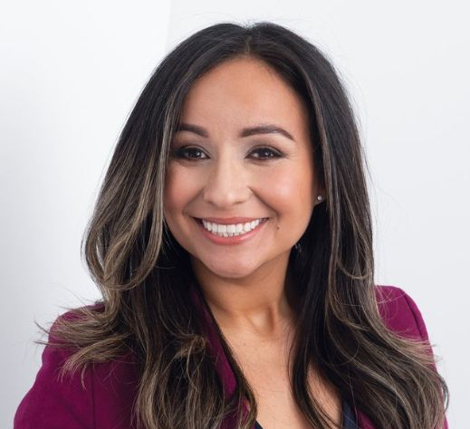
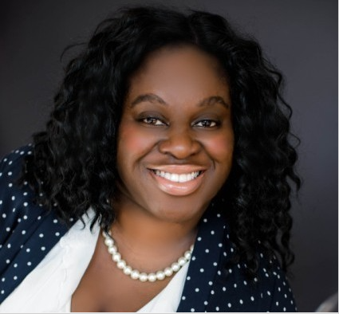
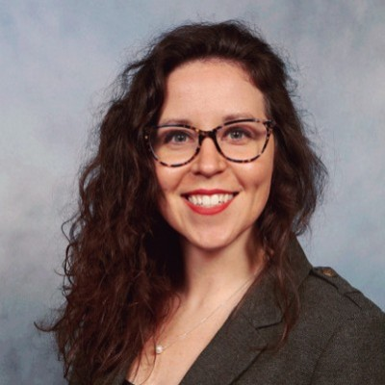
Non-Profit Focus Group
Marcela Hermosillo-Tarin
President
Ngozi Igbokwe
VP Community Relations
Ashley Jennings

Slide 2

Agenda
Welcome and introduction
Icebreaker
Discussion
Brainstorming
Feedback
Wrap up

Slide 3
Upcoming SIGS
Leadership SIG: October 20th, 2023
Book Clubs

Slide 4

ATD Power Membership
More Information @ www.atdiowa.org > Membership > ATD Power Membership
Why invest in a Power Membership?
Additional resources and research!
You can support ATD Central Iowa by sending part of your ATD Membership dues back to our Chapter by including our code CH 6013 on your application!
Notes:
Research and discounts are available! If you want to know more, check out the website! ☺

Slide 5

Join us on Facebook and LinkedIn!

Slide 6
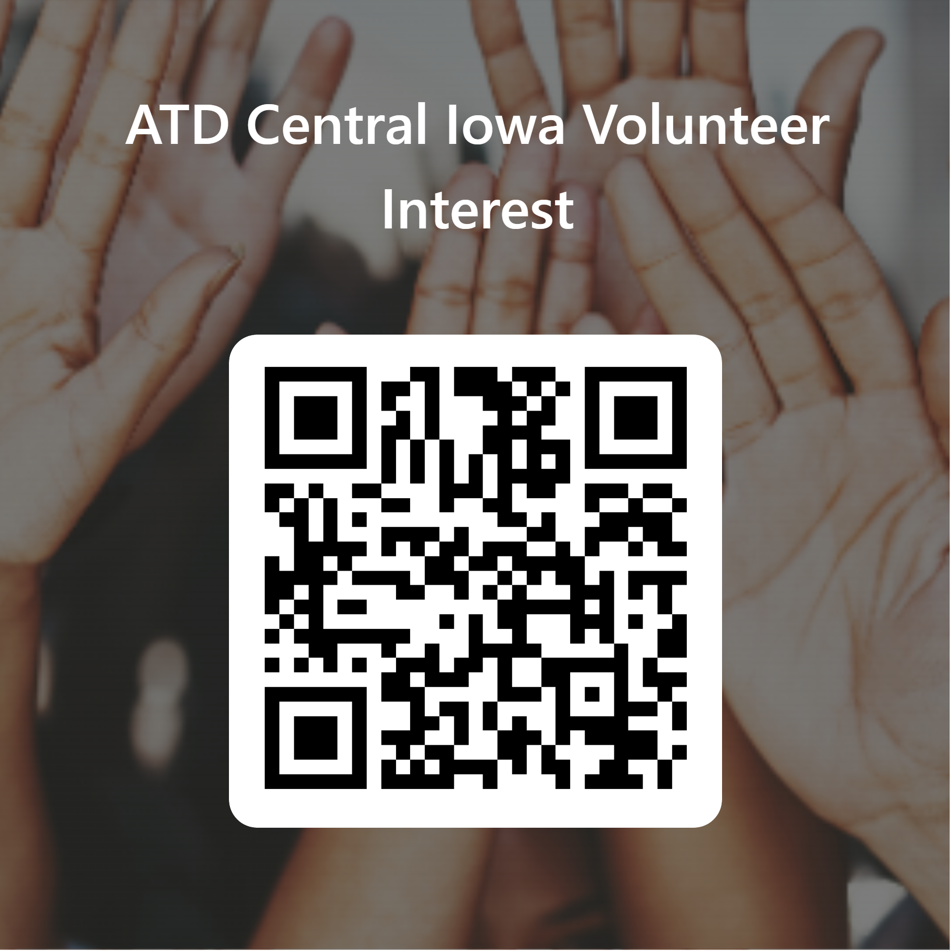
Volunteer Opportunities
Why volunteer?
Build connections and increase your network
Develop your professional and leadership skills
Increased visibility with industry leaders
Ability to facilitate/lead at events

Slide 7
October
October 13th
Gratitude: It Rewrites Your Brain and Changes Your Past, Present, & Future!
with
Ronee Andersen
Non-profit employees can attend Education events for FREE! Use code: NOTFORPROFIT2023!

Slide 8


Slide 9
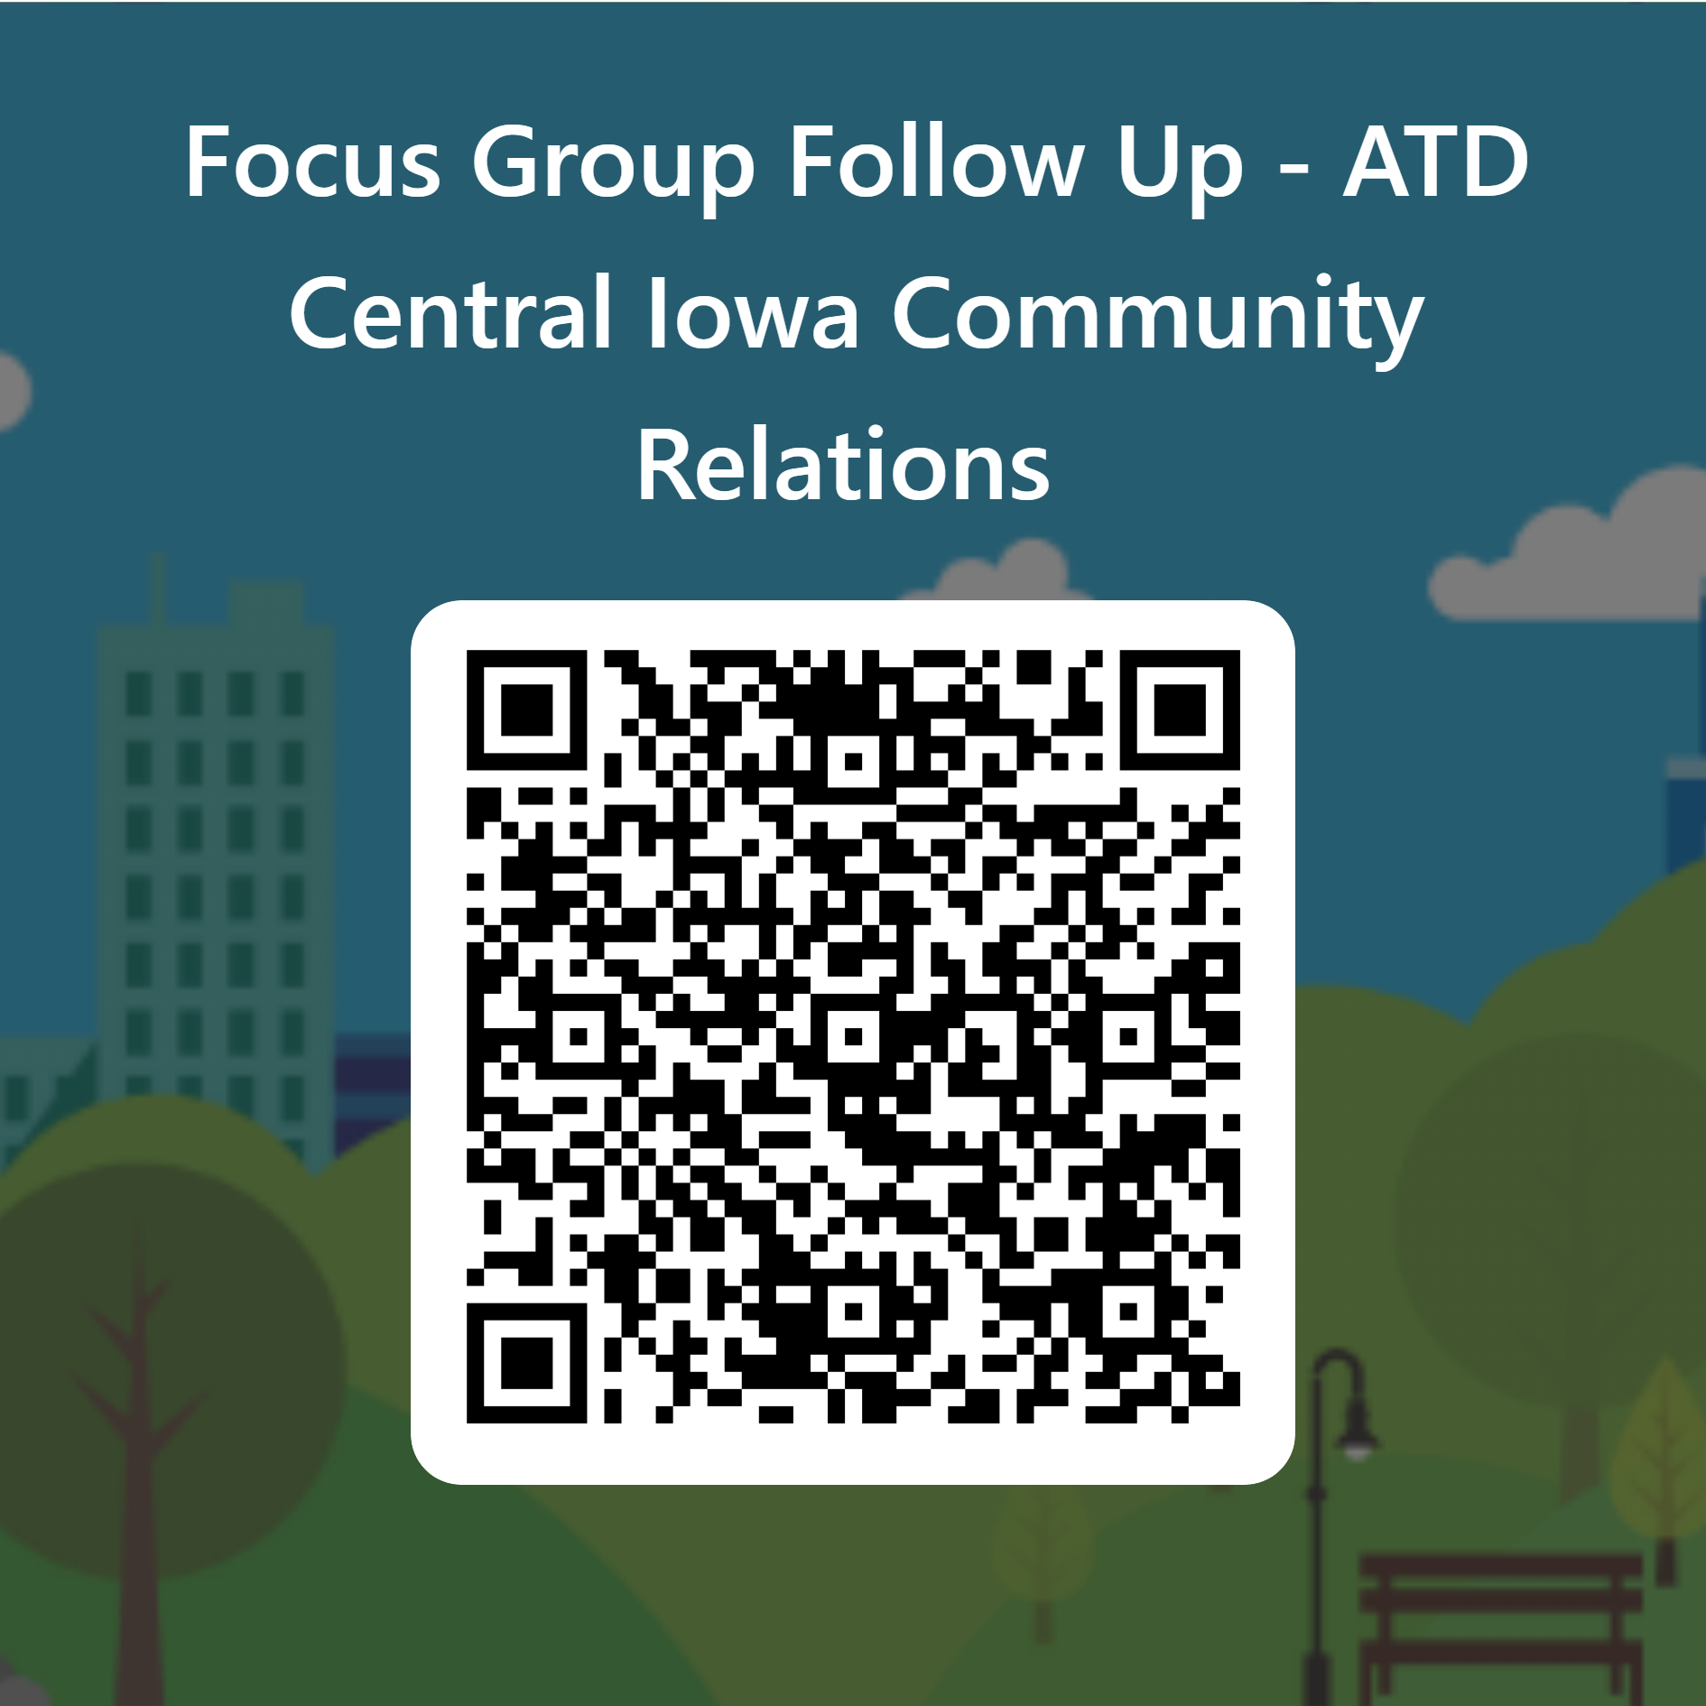
Focus Group Follow Up
Your feedback matters!
Please share your open and honest feedback!

