Slide 1
Welcome
CNY ATD
Leadership Team

Slide 2
Onboarding
Acquire knowledge about organization, its inner workings
Learn to understand your role as a leadership team member
Clarifying expectations
Help to become effective organization leadership team members
Leadership Team Onboarding
Notes:
What is onboarding – providing information about the organization and your leadership role
Leadership Team Onboarding discusses purpose and process

Slide 3
ATD
The world’s largest association dedicated to those who develop talent in organizations;
Supporting those who develop the knowledge, skills and abilities of employees in organizations around the world.
Notes:
What is ATD?...
World’s largest association dedicated to talent development professionals,
Supporting those who develop the knowledge, skills and abilities of employees

Slide 4
ATD
Mission
Empower professionals to
develop talent in the workplace
Notes:
Mission – to support the people who develop individuals

Slide 5
Evolved, Grown, Broadened
Linking the
development of people, learning and performance
to individual and organizational results
Notes:
Started in 1943, going into 75 years…… profession has evolved, grown, broadened…… to meet the growing needs of profession….. from training and development, to learning and performance, to linking to results/showing impact, to making a the name change to address overall organizational talent development

Slide 6
ATD Evolution
Training
Development
Learning
Performance
Results
Link to Goals
Notes:
from training and development, to learning and performance, to linking to results/showing impact/becoming an integral part, to making a name change to address overall organizational talent development

Slide 7
Talent Development
Shift to a knowledge society
Increasing productivity of workers
Improve current performance
Prepare for future
Talent will be the engine of business
How to develop talent?
Notes:
Why talent development
w/ shift to information and knowledge society over the last 50 plus years; 4th industrial revolution digital/technology
Businesses’ desires to continue to increase productivity
improving current performance and efficiency
Preparing workers for future
quickly changing workplace; quickly changing job skill needs
managing constant change, transition to new roles, new technologies, innovation
Acknowledging that talent, the development of knowledge, skills and abilities of the human capital of businesses, will be the foremost driver for business…… how to teach employees to learn better and faster; in many ways -classroom, e-learning, social, informal, microlearning

Slide 8
Talent Development Field Transformation
Organization needs
Employee needs
Talent Development functions
Interconnectedness
Organization structure
Differences in organizations
Finding, developing, retaining,
engaging and inspiring talent
Notes:
ATD conducted research on this transformation of the talent development field along with noting trends
Reviewed needs of organizations and employees to succeed
Identified the various functions that encompass overall talent development
Noted the interconnectedness of these functions across the organization
Drafted an organization framework for talent development
Recognizing that organizations’ needs may be different…… no 1 size fits all
With goal of aligning organizations to meet their business needs through finding, developing, retaining, engaging and inspiring talent in today’s knowledge environment

Slide 9
Talent Development Defined
Talent Development Framework
http://puzzle.td.org
Notes:
Results of the study was a defining of a talent development framework
- Right click to hyperlink for framework video
- Online tool to create your organization’s talent development structure, moving the function puzzle pieces around

Slide 10
Talent Development Primary Functions
Change management
Coaching
Compliance
Employee engagement
Evaluating learning impact
Executive development
Instructional design
Leadership development
Learning technologies
Managing learning programs
Needs assessment
Onboarding
Performance improvement
Performance management
Training delivery
Notes:
The 15 primary talent development functions defined from research
Some old standards – assessment, design, development, implementation, evaluation
Some addressing productivity, performance
Some looking at the future – change, technologies, coaching

Slide 11
Talent Development Secondary Functions
Assessments
Career Development
Compensation and Benefits
Competency Model Development
Cross-Cultural Training
Diversity and Inclusion
Knowledge Management
Fostering Innovation
Human Capital
Job Shadowing
Organizational Development
Organizational Effectiveness
Performance Consulting
Recognition and Rewards
Recruitment
Sales Enablement
Strategic Planning
Succession Planning
Talent Acquisition
Talent Engagement
Talent Management
Talent Mobility
Tuition Assistance
Workforce Planning
Notes:
The 24 secondary talent development functions defined from research

Slide 12
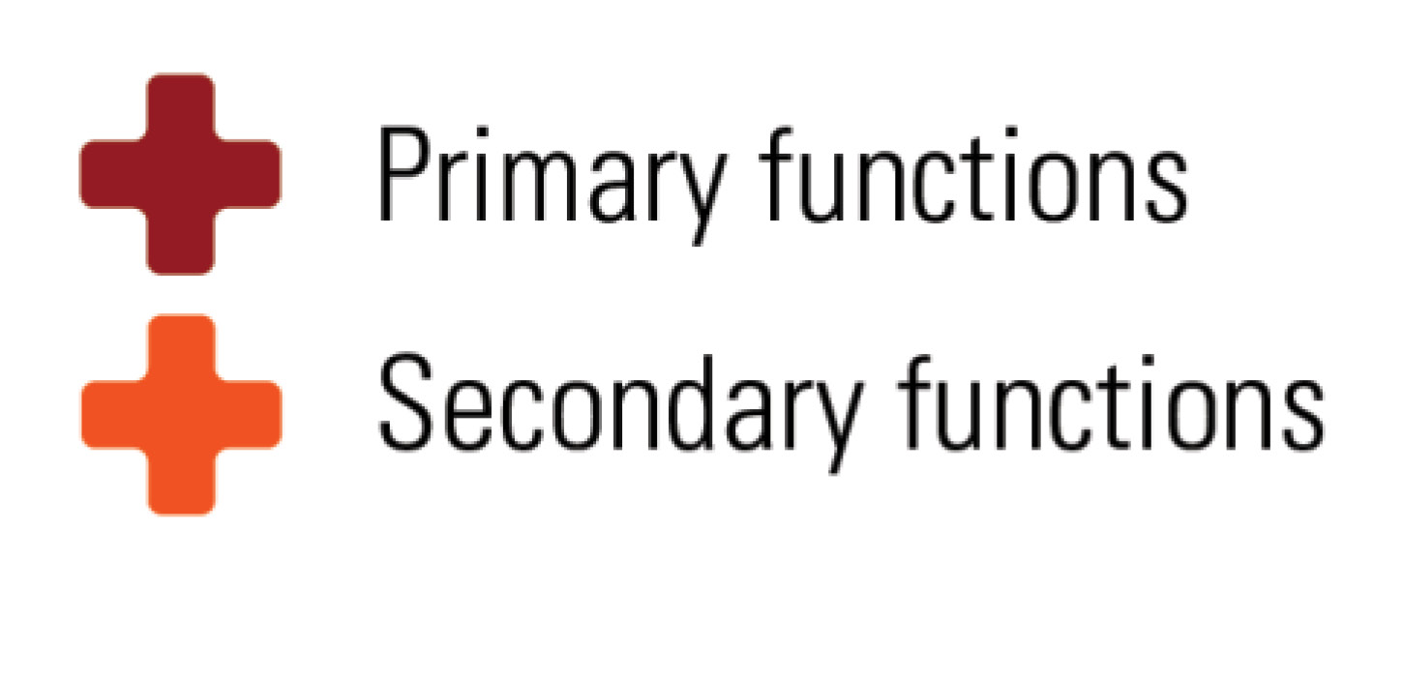
Talent Development
Notes:
An overall talent development framework/puzzle w/ the 15 primary talent development functions in red along with other secondary or occasional functions

Slide 13
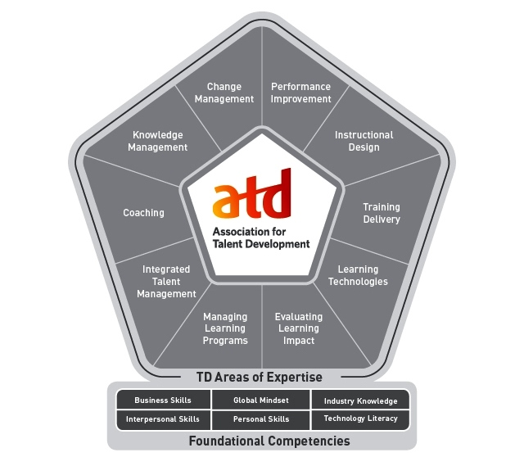
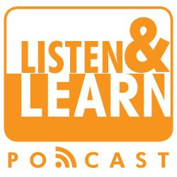
www.td.org
Notes:
ATD provides: research, public policy, publications (books, magazines), education, conferences, certificate programs

Slide 14
ATD Communities of Practice
Career Development
Global HRD
Government
Healthcare
Human Capital
Learning & Development
Learning Technologies
Management
Sales Enablement
Science of Learning
Senior Leaders & Executives
Notes:
Each community focuses on a key area or industry in the talent development field providing content, offerings, resources, discussions

Slide 15
ATD Publications
Notes:
TD is ATD's award-winning magazine covering industry best practices, emerging technologies, and trends.
TD at Work , a short format, practical resource featuring easy-to-apply tips, tools and content.
Books on various talent development topics

Slide 16
ATD Digital Resources
Notes:
Webcasts and podcasts by industry expert on various talent development topics – live and archived
ATD’s Online Library has a collection of over 3000 full-text periodicals, journals, and newspapers and hundreds of business books summaries

Slide 17
ATD Digital Resources
Notes:
ATD Links - In Practice articles with pragmatic discussions on applying learning and performance concepts in the field
The Buzz features executive summaries of noteworthy articles on training, workforce development, e-learning and other topics of importance to talent development professionals
Blogs by subject matter experts

Slide 18
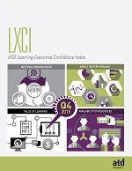
ATD Research
Notes:
ATD does a lot of research creating various white papers and reports
2 recurring reports by ATD research are
- State of the Industry – their annual review of talent development trends.
- The quarterly Learning Executive Confidence Index which assesses the expectations of learning executives for the learning function in organizations for the next six months

Slide 19
ATD Public Policy
Notes:
ATD public policy, government relations work
Developing and advocating for public policies that support building a highly skilled workforce
Monitoring bills introduced in senate and house that have a connection to or impact on training and talent development.
Bridging the Skills Gap…. Working w/ Dept of Labor on workforce training

Slide 20
ATD Education
Notes:
ATD offers a variety of online, face to face and on demand education programs, including certificate and master series programs in select disciplines

Slide 21
ATD Conferences
Notes:
ATD International Conference & Expo is largest conference in the talent development field w/
- Over 10,000 professionals in the learning field
- Over 300 educational sessions covering every aspect of the learning industry.
EXPO featuring more than 300 exhibitors providing the latest products and solutions.
Techknowledge asks the question How can technology take your talent development efforts to the next level? It’s the place to learn about the latest technology trends from thought leaders and practitioners who are on the leading edge

Slide 22
ATD Competency Model
* CNY ATD has 6 CPLPs *
Notes:
ATD Competency Model – created to define the talent development profession and the various areas of expertise for all those in the field….. the Model is the foundation for the only professional certification in the talent development field – the Certified Professional in Learning and Performance™ (CPLP)….. and the new APTD Associate Professional in Talent Development .
Assess your skills and knowledge with Skill Tracker

Slide 23
ATD Members/Affiliates
Members
120 Countries
Public and private organizations
Every industry sector
Affiliates
125 Chapters
International strategic partners
Global member networks
Notes:
Members – 120 countries
Chapters – 125, including Central New Yok

Slide 24
Local affiliate chapter of Association for Talent Development (ATD)
Covering 16+ counties from the Canadian border to the Pennsylvanian border in the central area of New York State
Award winning, nationally recognized
Celebrating 45 years in 2017
Notes:
What is CNY ATD…..
- Local affiliate ATD
- Proud to be celebrating 45 years
- Proud to have had received numerous national and local recognitions including 16 ATD recognitions…..

Slide 25
Purpose
To promote professional activities
for talent development* professionals
also defined as training, development, learning and performance
Update words for TD puzzle thru slide 27
By-Laws
Notes:
Our Purpose – from by-laws……. We’re about talent development which we also define as training, development, learning and performance
ByLaws identifies organization and states how governed

Slide 26
MISSION
Connecting talent development
professionals throughout the region, while contributing to the growth and
recognition of the profession
Notes:
Our mission…. Connecting, contributing, recognizing

Slide 27
Membership
Open to those who have interests in
talent development including training, development, learning and performance
Membership Policy
Notes:
Who we are – Membership association – from by-laws…… those interested in talent development
Membership Policy details classification, dues, renewals and lapses

Slide 28
Membership
CNY ATD’s over 140 members are
professionals representing varied organizations as employees and independent consultants
Notes:
Who are our members

Slide 29
CNY ATD Member Benefits
Networking with local peers
Sharing experiences and best practices
Professional development & informal learning
Resource for talent development
Notes:
Benefits of membership…….. networking, sharing experiences, learning opportunities, resource

Slide 30
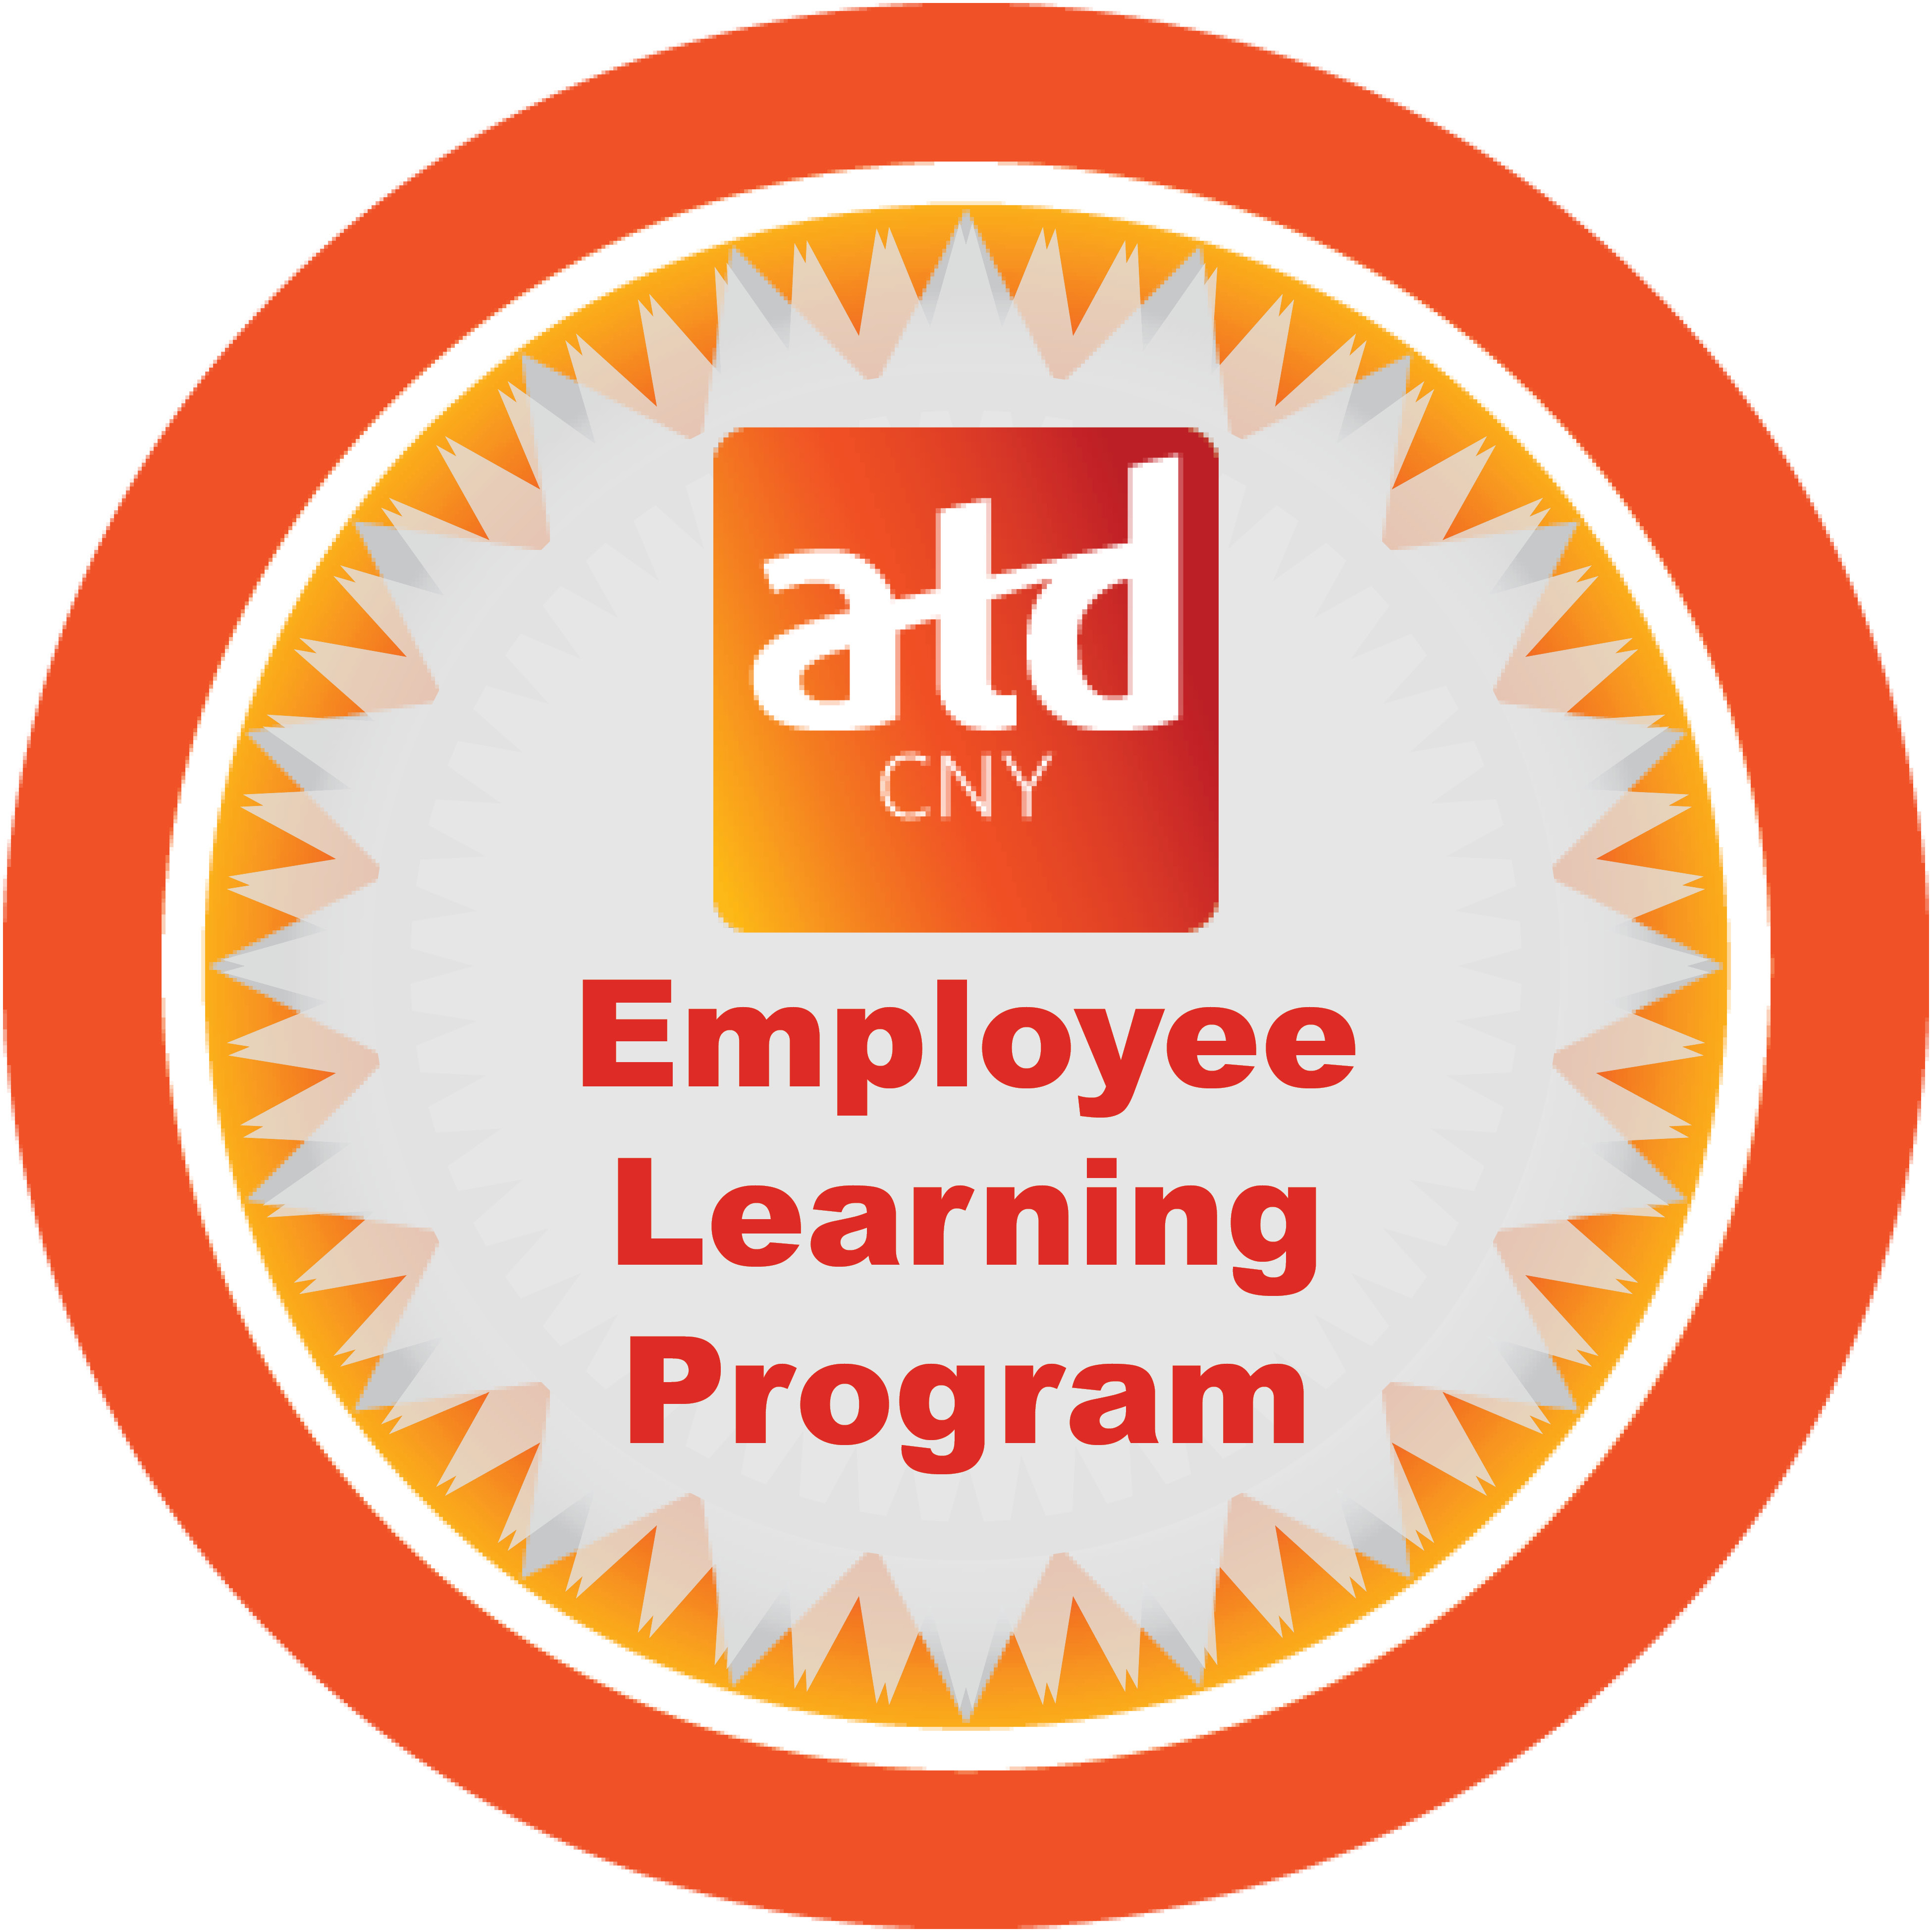
CNY ATD Programs
Networking & Informal Learning Activities
Professional Development Programs
Emerging
LinkedIn Group Discussions
Career Center
Notes:
How we meet our mission and what we do – an overview of all our programs

Slide 31
CNY ATD Committees
Membership
Programs
Emerging
Notes:
How we accomplish meeting our mission thru our committees…… it’s where you can get involved in organization, where good connections are made

Slide 32
CNY ATD as a Resource
Review emails and website for information
Attend upcoming CNY ATD activities
Connect/Follow/Join CNY ATD on LinkedIn
Get involved on a CNY ATD committee
www.cnyastd.org
Notes:
CNY ATD as a resource for members and talent development community

Slide 33
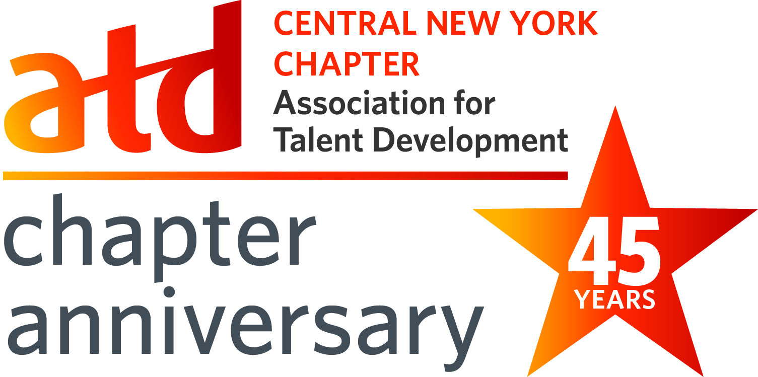
CNY ATD History
Started in 1972
45th Anniversary in 2017
2006 - ‘Back from the Brink’
Recognitions
Notes:
Some history – 45th Anniversary in 2017

Slide 34
CNY ATD Brink
Membership – significant loss, down to 70
Financial - $ 5,000 loss
Activities - few
Engagement (encounters) – low
Involved (volunteers) – minimal
Leadership – resigned
Notes:
In 2006, crisis……

Slide 35
CNY ATD Back from…
Membership – up to 160; generally over 140
Financial – excess cash exceeds $ 5,000
New Initiatives ^{Curation}
Engagement (encounters) – over 60%
Involved (volunteers) – over 30%
Leadership – strong committees
Notes:
w/ recommitment from new leadership and hiring of managing director, CNY ATD came back from the brink
Bringing structure, strategic direction, new initiatives, stability, growth and excellence to CNY ATD

Slide 36
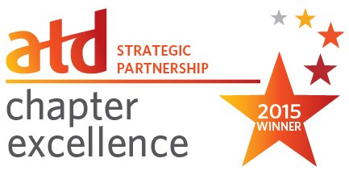
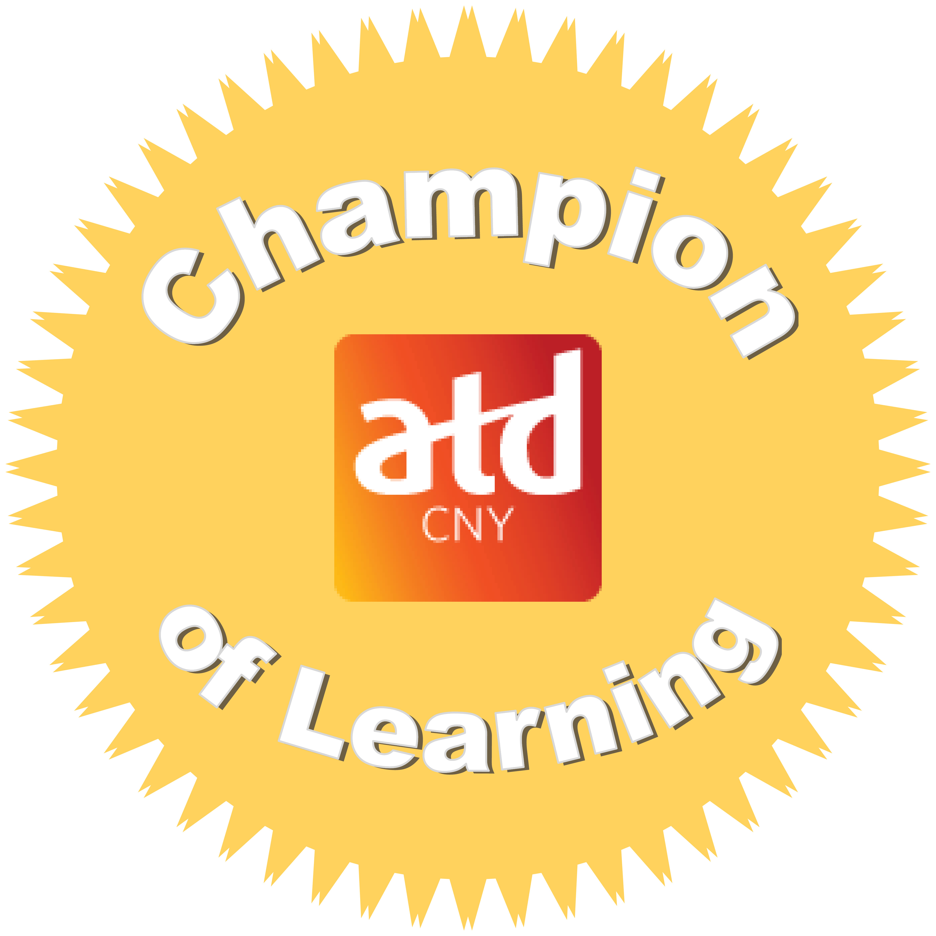
CNY ATD Recognitions
CNY ATD Scholarship Program
Train-the-Trainer Program
Community Recognition Program
CNY BEST Learning and Performance Program
Employee Learning Week Program
CNY ATD Orientation
Curation
Economic Champion
Notes:
brief history – since 2006, achieved excellence, resulting in numerous national and local recognitions including 16 ATD recognitions….. Proud of success & recognitions
award winning programs – Scholarship, Train-the-Trainer, Community Recognition, CPLP, CNY BEST, Employee Learning, Orientation, Curation

Slide 37
Moving Ahead
Strategic direction
Continuous improvement
Strengthening operations
New opportunities
Notes:
Moving ahead….. Continue to get even better

Slide 38
Notes:
Visual of current organization - showing individual areas contributing to mission and goals
Area Overview document provides an overview of areas which are covered on next slides

Slide 39
Strategic Planning
Purpose
Oversee governance and operations for organization
Set strategic direction of organization
Activities
Operational planning and reviews
Strategic planning
Office of the President meetings
Board meetings
Responsible – Office of the President

Slide 40
Finance
Purpose
Oversee finances for organization
Maintain financial controls for organization
Activities
Financial planning and reviews
Maintain and review financial controls
Responsible – Office of the President

Slide 41
Membership
Purpose
Strengthen CNY ATD through membership
Activities
Prospecting for members
Retention of members
CNY ATD Orientations
Responsible – VP Membership
http://cnyastd.org/membership1

Slide 42
CNY BEST
Talent Development
Recognizing excellence in
talent development in the CNY area
10th Anniversary
Notes:
CNY BEST – our national award winning annual recognition of excellence in talent development in the local area…… in its 10th year
Nominations for the CNY BEST awards are submitted culminating in our showcase CNY BEST Awards Ceremony
Then we follow up w/ a Sharing the BEST program where CNY BEST nominees share information and experiences around their nominated practice

Slide 43
CNY BEST
Purpose
Recognize excellence in talent development
Activities
CNY BEST program, Awards Ceremony
CNY BEST Information Sessions
CNY BEST Buddy System
Sharing the BEST program
Responsible – VP CNY BEST
http://cnyastd.org/cny_best

Slide 44
Train-the-Trainer (TTT)
Overall Learning Goals
develop skills to conduct a thorough and effective assessment
use adult learning principles to design effective training
deliver engaging training using effective presentation and interaction skills
Notes:
CNY ATD’s Train-the-Trainer program - Providing key skills for anyone who educates an audience: New Trainers, Subject Matter Experts, Sales People, Presenters/Speakers, Facilitators…….. Improving the confidence of trainers

Slide 45
Train-the-Trainer (TTT)
Purpose
Provide for CNY ATD’s Train-the-Trainer programs
Activities
Determine content of programs
Deliver programs
Responsible – VP Professional Credentials
http://cnyastd.org/ttt

Slide 46
CPLP
CNY ATD CPLP Resources
CPLP Information Sessions
CPLP Study Resources
CPLP Coaches
Notes:
CPLP - For those interested in the Certified Professional in Learning & Performance, CNY ATD has resources to help you think about and pursue the designation including information sessions and coaches who are CPLPs and have been through the process
New Associate Professional in Talent Development (APTD) – for those with less experience than required for CPLP…. More details coming

Slide 47
CPLP
Purpose
Promote CPLP program
Support members interested in certification
Support CPLP members
Activities
CPLP Coaches/Coaching
CPLP Information Sessions
Responsible – VP Professional Credentials
http://cnyastd.org/cplp

Slide 48
CNY ATD Programs
Professional Development
Networking
Learning Roadshow
Notes:
To meet our goals of connecting professionals and sharing experiences….
Providing formally developed programs and workshops around talent development topics
Networking opportunities – to meet and connect w/ peers in a primarily social setting

Slide 49
Programs
Purpose
Provide formally developed learning and networking programs for CNY ATD
Activities
Develop calendar of programs
Coordinate with area program facilitators
Provide programs
Responsible – VP Programs
http://cnyastd.org/programs

Slide 50
Employee Learning
Celebrating Employee Learning
Create AWARENESS of learning
PROMOTE learning objectives
RECOGNIZE learning achievements
Show IMPACT of learning
Notes:
The Employee Learning Program is an awareness campaign highlighting the important connection between learning and achieving organizational results……
Encouraging organizations and individuals to celebrate employee learning all year long…. With lots of ideas

Slide 51
Employee Learning
Purpose
Encourage celebrating of employee learning
Activities
Employee Learning awareness
Employee Learning hosted Programs
Responsible – VP Employee Learning
http://cnyastd.org/employee_learning

Slide 52
Emerging
Purpose
Provide forum for current and emerging talent development information
Activities
Identify and present talent development information through curation, discussion or other approaches
Shop Talks
Responsible – Emerging Chair
http://cnyastd.org/emerging

Slide 53
Scholarship
Encouraging and supporting
professional development
and continuing education
in the field of talent development
6th year
Notes:
CNY ATD established the CNY ATD scholarship to encourage professional development and continuing education in talent development…. We support professional development, certification, train-the-trainer and CPLP programs, conferences, work towards masters, doctorates
…. And funds are raised in various ways, including the annual CNY BEST silent auction and raffle – always looking for donations

Slide 54
Scholarship
Purpose
Manage the CNY ATD Scholarship Program
Activities
Awarding scholarship recipients
Implement fund raising for scholarship program
CNY ATD Scholarship Silent Auction/Raffle
Responsible – Scholarship Chair
http://cnyastd.org/scholarship

Slide 55
Recognition
Purpose
Achieve recognition for CNY ATD and its members
Activities
Identify and submit for recognitions
Responsible – Office of the President
http://cnyastd.org/cny_atd_recognitions

Slide 56
Community Outreach
Purpose
Increase awareness of CNY ATD and its activities within community
Activities
Identify and implement community awareness opportunities
Responsible – Office of the President

Slide 57
Sponsorships
Purpose
Provide opportunities to support CNY ATD through sponsorships
Activities
Develop sponsorship opportunities
Solicit sponsors
Responsible – Office of the President
http://cnyastd.org/sponsors

Slide 58
Social Media
Purpose
Engage CNY ATD, its members and talent development community in social media
Activities
Implement social media strategies
Responsible – Managing Director
Connect to CNY ATD
Follow CNY ATD Company
Join CNY ATD Group
@cnyatd - Follow
#cnyatd
#cnybest
#cnyelp

Slide 59
Admin/Marketing
Purpose
Oversee organization operations
Promote organization and its activities
Activities
Maintain information and records for organization
Handle communications for organization
Develop and submit promotional materials for organization and its activities
Responsible – Managing Director

Slide 60
Goals
Mission Goals
Increase Connections | Increase Growth | Increase Recognition
Organization Goals
More Members | More Revenue | More Engagement/ Involvement
Notes:
Mission goals tie to mission – connecting, contributing to growth, recognition of profession
Which leads to organization’s goals of members, revenue, engagement/involvement…. the ones that support the continued success of the organization….. ones we monitor….our primary dashboard goals

Slide 61
Leadership Team
Board of Directors
Committee Chairs
Committee Vice Chairs
Office of the President
Managing Director
Organization and Leadership Structure Policy
Notes:
LT covering all the areas of responsibilities operationally and strategically ……
Board – voting LT members w/ more expectations like board meeting attendance, national membership
Committee chair w/ vice chairs
Office of the president – executive committee
Managing director

Slide 62
Office of the President
Executive Committee
President
President Elect
Executive VP
Past President(s)
Managing Director
Support for Leadership Team and areas
Here to help; Contact with concerns, issues
Office of the President Buddy
Office of the President Summary Guideline
Office of the President Buddy System
Notes:
- Working as a team for overall operational management and strategic planning
and, to support LT – use us to help, discuss issues or concerns, keep us informed of things
OP buddy…..

Slide 63
Managing Director
To help volunteers be more successful;
To help leaders be more strategic
Focal point for organization
Maintains records – source for information
Ensuring continuity
Support/backup for volunteer activities
Managing Director Summary Guideline
Notes:
Managing director here to help…… w/ information, support, backup when needed

Slide 64
Policies/Expectations
Board Members
Committee Chairs
Committee Vice Chairs
Committee Members
Other Items
By-Laws/Policies/Guidelines/Procedures Index
Notes:
some policies and expectations to review….. the index lists all the organization documents w/ the documents in dropbox

Slide 65
Board Members
Policy: CNY ATD and ATD memberships required
Expectations
Attendance at board meetings
Understand overall organization and activities
Be ambassador for CNY ATD
Contact OP with any issues/concerns regarding meeting responsibilities
Board Member Policy
Board Member Expectations
Notes:
Board – membership in CNY ATD AND ATD required;
key expectations – along w/ understanding organization and being ambassador, attendance at board mtgs - really important for organizational discussion and necessary item approvals
Note re committee chairs – you are invited to attend and will receive invitation for all board mtgs, but not required to attend
And – please, please contact Office of the President with ANY issues or concerns, and EARLY

Slide 66
Board Meetings
Strategic discussions/planning
Operational planning
Reviewing/managing operations
Board Meeting Expectations/Guidelines
Board Meeting Facilitation
Notes:
Board meetings are for strategic discussions and operational planning and review…. Emphasis on strategic
Monthly mtgs, 2nd Fri, 9-10:30am, primarily conference calling… please let us know your attendance monthly
Meeting documents will be in dropbox w/ approval items noted on agenda….. Please review documents beforehand
Board Meeting Expectations/Guidelines gives an overview of meetings w/ expectations, ground rules and meeting etiquette

Slide 67
Committee Chairs
Policy: CNY ATD membership required
Expectations
Understand area of responsibility
Understand overall organization and activities
Be ambassador for CNY ATD
Succession planning – select Vice Chair
Contact OP with any issues/concerns regarding meeting responsibilities
Committee Chair Policies and Expectations
Notes:
Committee chairs – membership required;
key expectations – understand your area and organization; create awareness, spread the word, engage others in CNY ATD; select a vice chair…. And most importantly – please, please contact office of the president with ANY issues or concerns, and EARLY – we can help you discuss options – we’re here to support you to ensure things get done that should get done

Slide 68
Committee Chair Guidelines
Don’t try to do it alone!
Recruit committee members
Select Vice Chair
Committee meetings
Schedule regular monthly meetings
Provide virtual option
Don’t reschedule - Vice Chair backup
Reminders, agendas, minutes
Pass on upcoming activity information
Committee Chair Guidelines
Notes:
Don’t try to do everything yourself – make sure you have a good size committee – constantly be recruiting, and have a vice chair to be your backup and support
Regular meetings are important to the success of a committee, and reminders, advance agendas and minutes are good tips……. Committee Best Practices document good tips for committees….. And, please pass on upcoming activities information to committee members – so they are aware of activities, asking them to spread the word

Slide 69
Committee Vice Chairs
Policy: CNY ATD membership required
Expectations
Understand area of responsibility
Understand overall organization and activities
Be ambassador for CNY ATD
Support Chair and committee
Succession to Chair
Committee Vice Chair Policies and Expectations
Notes:
Committee chairs – membership required;
key expectations – understand your area and organization; create awareness, spread the word, engage others in CNY ATD; provide support for committee chair and committee; succession to chair

Slide 70
Committee Members
Policy: CNY ATD membership required
Expectations
Attend committee meetings
Perform committee-related activities
Ambassador for committee and CNY ATD
Committee Member Policies and Expectations
Notes:
Committee members – membership required; if lapse, Brenda will let you know
key expectations – attend committee meetings; do action items; promote committee’s activities; spread the word about other CNY ATD activities

Slide 71
Committee Best Practices
Committee Make-up
Committee Meetings
Committee Member Expectations
Support
Succession Planning
Committee Best Practices
Notes:
Best practices for running committees – Committee Best Practices document
Make up of committee - size, recruit, welcome
Meetings – scheduled, virtual option, reminder, agenda, minutes
Members expectations – attend meetings, committee-related tasks
Support – office of the president buddy, MD
Succession Planning – vice chair

Slide 72
Ambassadors
Leadership Team as Ambassadors Guideline
CNY ATD Programs flyer
Upcoming Activities flyer
Notes:
Be an ambassador - creating awareness, spreading the word, engaging others
Some documents to help you be aware of CNY ATD and its activities
Leadership Team as Ambassadors lists the various things you should now and ways to support each area
Programs flyer lists our various programs and activities
Upcoming activities flyer – emailed to you before your committee mtgs, lists activities….. Share this information w/ your committee members, keep them up to date on what’s going on and ask them to spread the word

Slide 73
CNY ATD Communication
Organization Name
CNY ATD
Not CNY-ATD, or CNYATD or ATD
Organization Logo
Organization Communication Guidelines
Notes:
Couple items to remember from the Organization Communications Guideline
Name of organization is CNY space ATD, not w/ a dash, not w/o the space and not just ATD
That’s our logo – use it wherever appropriate to represent the organization – the logo file is available on Dropbox in the organization folder or ask Brenda for it

Slide 74
CNY ATD Marketing
Promotions
Website, Email, Media notices, Social Media
Schedule activities as far out as possible
Programs, Committee meetings
3-4 months in advance; 2 months minimum
Check CNY ATD calendar
Send information to Managing Director
Organization Marketing Guideline
Notes:
From the Organization Marketing Guidelines….. We promote activities in various ways, and to allow good promotion activities should be scheduled far enough in advance as possible…..preferably at least 3 to 4 months in advance, minimum 2 months in advance
- check dates with CNY ATD calendar on web and Managing Director before finalizing dates
- and send Managing Director information as soon as its known to allow start of promotion of activities
Activity, date, time, and location, as soon as known
Event title and brief description, when available, at least 2 months before

Slide 75
Other Policies/Guidelines
Informal Activities Guidelines
Major Expense Policy
Collaboration Policy
Collaboration Agreement
Notes:
Couple other policies of note….
- Procedures for informal activities like information sessions, shop talk, other small, informal activities
- Sometimes ideas come up that get into expenses not budgeted for or collaboration ideas… these 2 policies discuss the process for these ideas – planning and timelines starting w/ bringing the ideas to Office of the President attention BEFORE any further discussions or commitments

Slide 76
Strategic Assessments
Strategic Assessment
Strategic Assessment Action Items
Notes:
Strategic assessment done in 2016-7 w/ action items reviewed in 2017

Slide 77
Other Information
Managing Director contact information
brenda@acme-planning, 315.727.1008, info@cnyastd.org
Conferencing Services
CHiP Code – CH2001
ATD Chapter Leader Membership Application
CNY ATD/ATD Acronyms/Terms
ATD Chapter Resources
Leadership Team Miscellaneous Information
Notes:
You should all have Brenda’s email and phone contact info in your contacts… for emergencies, txt Brenda
We have a conferencing services account w/ FreeConference – instructions - Conference Calling Information document
CHiP - ATD revenue sharing program for purchases like books, conferences and national memberships using the CHiP code – ours is CH2001…. You can find this code on the Curation webpage or on the Leadership Team Miscellaneous Information document
Discounted rate for chapter leaders to join/renew ATD memberships … remember, board members requirement
We have loooooots of acronyms and terms….. Document to help decipher this alphabet city
ATD provides lots of resources to assist chapters - 2 documents show various things they provide

Slide 78
Thank You
CNY ATD
Leadership Team
Notes:
Any questions – contact OP Buddy or MD
Thanks for providing your service as a CNY ATD leadership team member

