Slide 1
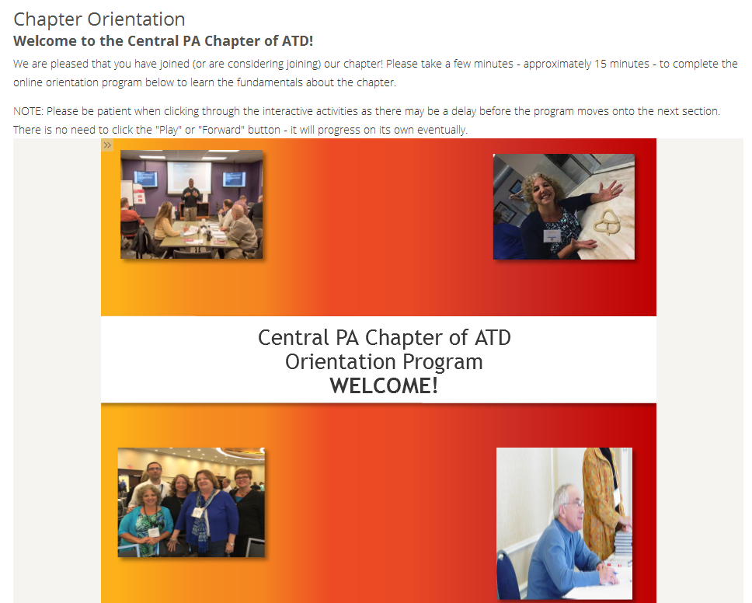
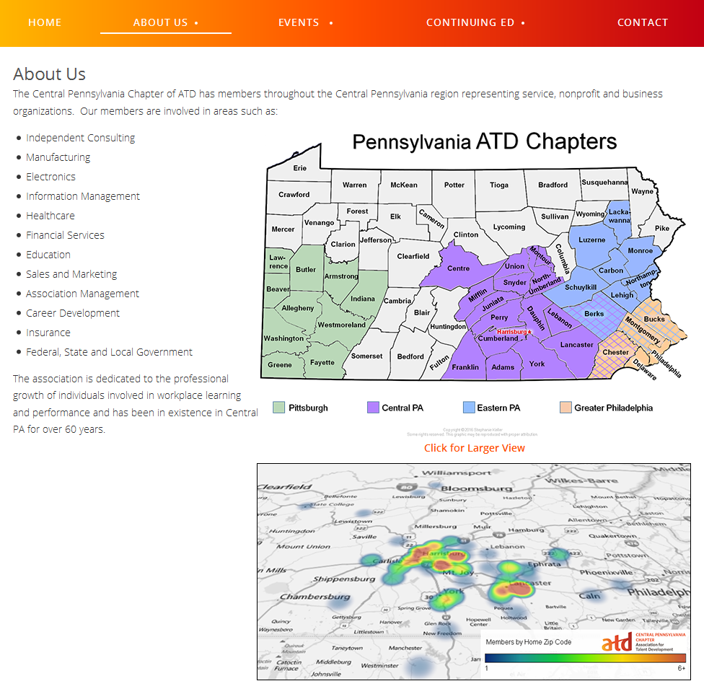

Membership Team
The Membership Team:
  Defines & communicates chapter benefits
  Reaches out to new and renewing members
  Welcomes new and prospective members at events
  Manages the annual Member Needs Survey
  Designs & implements member engagement strategies
ADD PICTURES /ACCOMPLISHMENTS
Chapter Map: ATD “Sharing Our Success” Winner
"Developing a brand new online orientation program for the Central PA Chapter of ATD has been a phenomenal experience. The Membership Task Force helped me develop new software knowledge and skills, and provided best practices for graphic design. They enhanced my professional growth and encouraged me to be creative and apply concepts I've learned in class. I would recommend working with ATD if you are looking to learn and get a hands-on experience that will boost your resume and skill set in general.“
~Alixandra Moyer
“Being on the Membership Task Force has kept me engaged and interested in ATD.”
~Skip Brown

