Slide 1
ASTD Sacramento is pleased to Welcome you to DemoFest 2011 “An E-Learning Event”

Slide 2
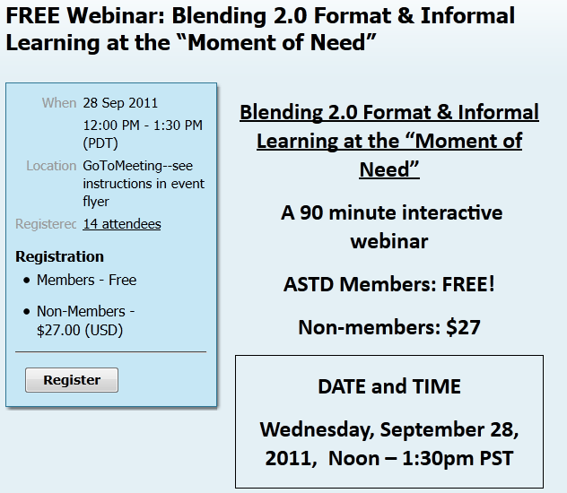
Sacramento ASTD Upcoming Event September 28th

Slide 3
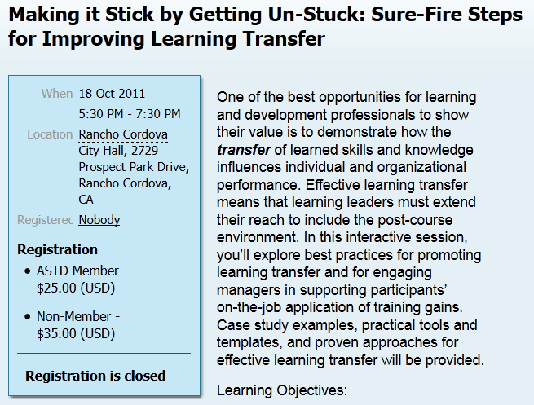
Sacramento ASTD Upcoming Event October 18th

Slide 4
Ask any of the ASTD Board or current
members about the many benefits of
becoming
a member of - - -
ASTD Sacramento

Slide 5
Sacramento ASTD Member Benefits

Slide 6
Sacramento ASTD Member Benefits

Slide 7
Sacramento ASTD Member Benefits

Slide 8
Sacramento ASTD Member Benefits

Slide 9
Sacramento ASTD Volunteer Opportunities

Slide 10
Sacramento ASTD Volunteer Opportunities

Slide 11
Sacramento ASTD Volunteer Opportunities

Slide 12
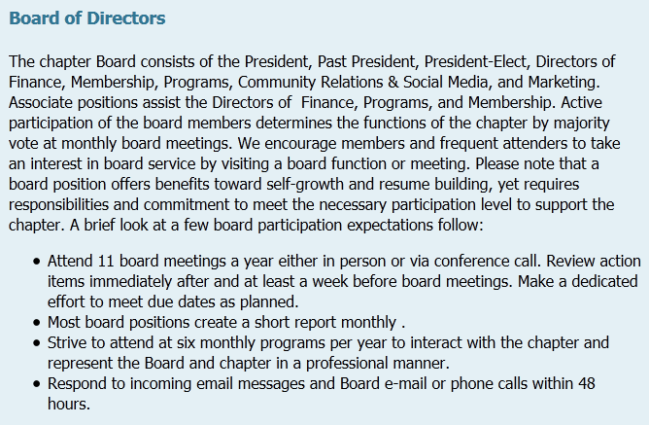
Sacramento ASTD Volunteer Opportunities

Slide 13
Sacramento ASTD Volunteer Opportunities

Slide 14
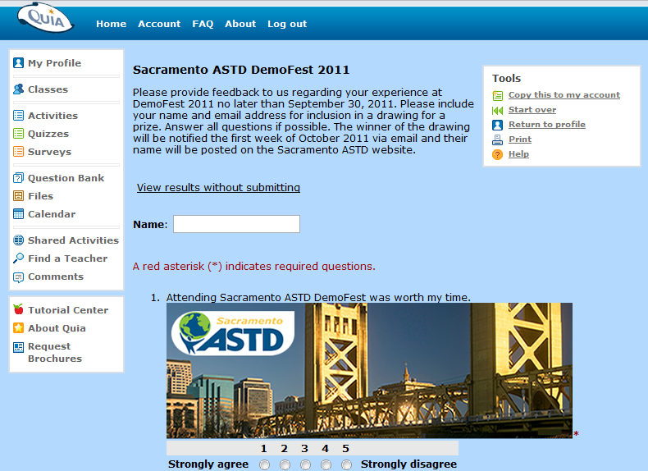
Complete the Survey to win $100 Gift Certificate
Look for an email from ASTD Sacramento requesting feedback on DemoFest 2011. The URL link will be in the email
http://www.quia.com/sv/544046.html

Slide 17
SAVE THE DATE The Leadership Challenge Forum 2012 and 25th Anniversary Celebration Thursday July 26th & Friday 27th, 2012 San Francisco, CA

Slide 18
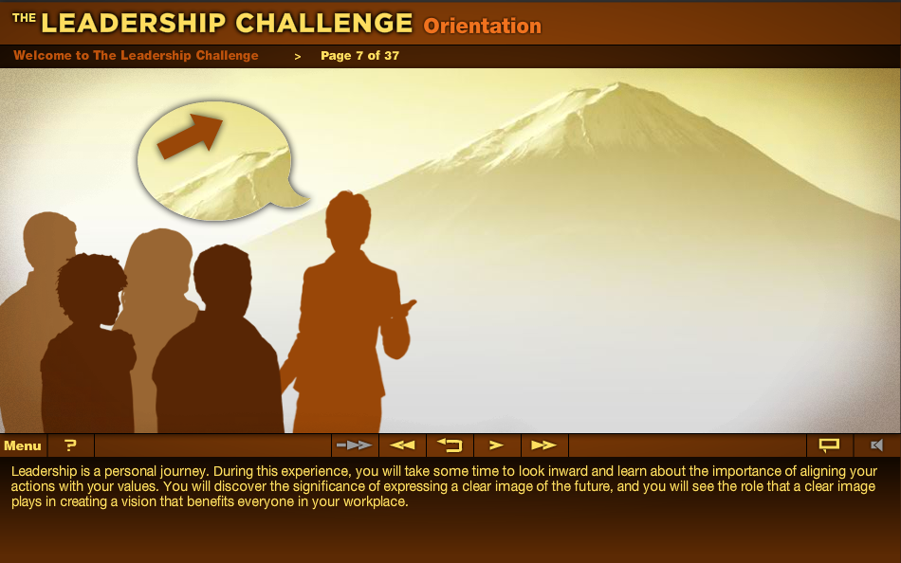
Self-directed learning, at your own pace
With The Leadership Challenge e-Learning Program, participants can:
• Schedule coursework around personal and professional lives
• Learn at their own pace, moving along as they master each module
• Engage the program anywhere they can access a computer
• Accommodate their own learning style
You can use The Leadership Challenge® e-Learning Program as a general introduction to leadership, a companion course to the LPI, or a cost effective solution for a team or group.
There’s no more versatile, economical way to make “leadership everyone’s business” in your organization.

Slide 21
Performance Solutions
Custom Online Training
Training Support – Online
Online Assessment

Slide 22
Complete the Survey to win $100 Gift Certificate
Look for an email from ASTD Sacramento requesting feedback on DemoFest 2011. The URL link will be in the email
http://www.quia.com/sv/544046.html

Slide 24
Instructional Design for eLearning Certificate Program
The bridge between technology and education
For more information:
Visit our booth here at Demo Fest.
Visit our website at www.cce.csus.edu/idl.
Contact a program representative at 916-278-4433.

Slide 25
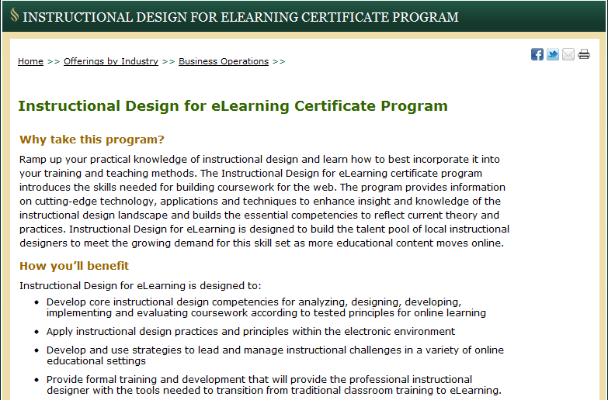

Slide 28
SkillSoft is Repeatedly Awarded
Best IT Content – 2007, 2008, 2009, 2010 Best Soft Skills Content – 2007, 2008, 2009 Best Compliance Content – 2008,2010
TrainingIndustry.com – Top 20 IT Training Companies, 2008, 2009,2010
Top 20 Learning Portal Companies 2010
Excellence Awards for: Best Learning Management System for SkillPort, Best Leadership Development Program for SkillSoft Leadership Advantage, and Best Soft Skills Content for SkillSoft Business Skills Library- 2010
Highest Satisfaction large enterprise LMS, 2007
Military Training Technology Magazine Top Training and Simulation Company, 2008
Brandon Hall Excellence in Learning Technology Best Advance in Virtual Classroom, 2009
LearnX Asia Pacific Platinum Award, 2009; Gold Award, 2008
Learning Leader – 2007 for KnowledgeCenters

Slide 29
Why SkillSoft?
SkillSoft solutions and expertise help our customers deliver meaningful business results
Market Leadership – 3,000 customers, 11+ million end-users
Innovation – $40-50m R&D invested annually
Experience –numerous and tenured client facing experts
Flexibility – adaptable offerings and business terms
Depth & Breadth - comprehensive e-learning portfolio
Thought Leadership – best of breed without aggregation
Quality – repeatedly recognized and awarded
Global Reach – present in 58 countries, support for 19 languages
Customer Service – extremely high loyalty, year after year
Results – proven track record for business impact and ROI

Slide 30
SkillSoft’s Customer Satisfaction
98% of customers would recommend SkillSoft’s products to a friend or colleague
2007 2008 2009 2010
Ease of doing business 96% 94% 96% 96%
Product reference 96% 93% 97% 98%
Customer service 95% 93% 96% 95%
Product quality 97% 94% 96% 97%
Intent to repurchase 93% 93% 92% 97%
Based on scientific survey conducted by an independent research firm, TNS, the world’s largest custom research company
643 SkillSoft customers participated in this year’s survey
SkillSoft exceeds industry averages in all areas

Slide 31
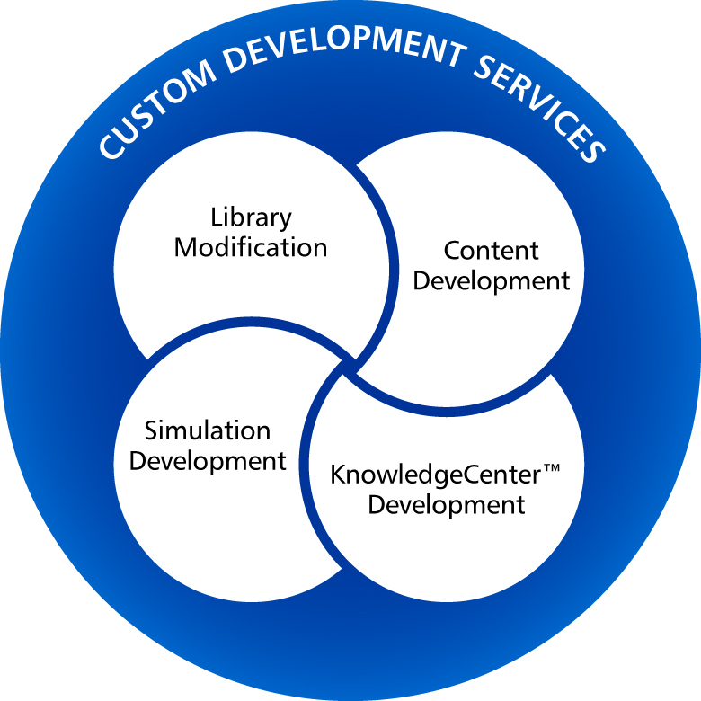
SkillSoft Custom Development Services
Scalable:
Flexible:
Consultative:
Instructional/Creative Expertise:
Integrated solutions:

Slide 33
Complete the Survey to win $100 Gift Certificate
Look for an email from ASTD Sacramento requesting feedback on DemoFest 2011. The URL link will be in the email
http://www.quia.com/sv/544046.html

Slide 34
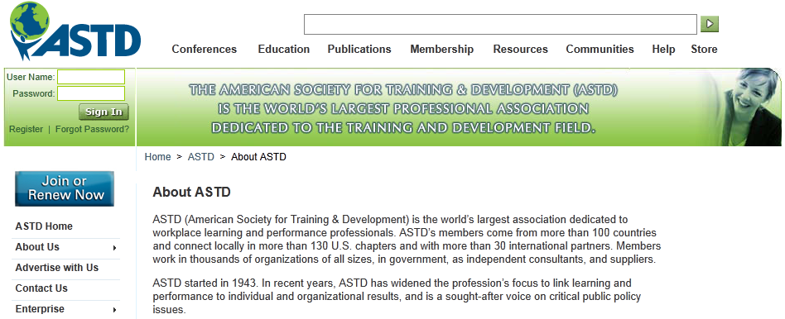
ASTD National
About ASTD
ASTD (American Society for Training & Development) is the world’s largest association dedicated to workplace learning and performance professionals. ASTD’s members come from more than 100 countries and connect locally in more than 130 U.S. chapters and with more than 30 international partners. Members work in thousands of organizations of all sizes, in government, as independent consultants, and suppliers.
ASTD started in 1943. In recent years, ASTD has widened the profession’s focus to link learning and performance to individual and organizational results, and is a sought-after voice on critical public policy issues.

