Slide 1
DemoFest 2011 Survey Results
Sacramento ASTD

Slide 2
Background information
65 responses received
143 signed up
140 attended
Date: September 23, 2011
Location: Rancho Cordova City Hall
Sponsors: Articulate, CSUS CDE, Los Rios CCD, SoftSkills, Wiley/Pfieffer

Slide 3
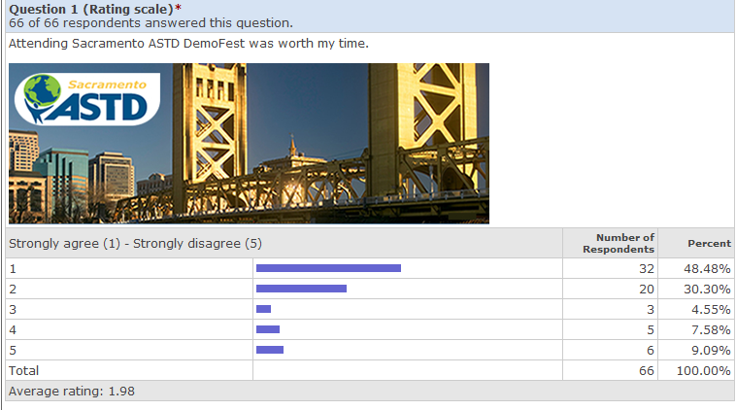
1. Event information

Slide 4
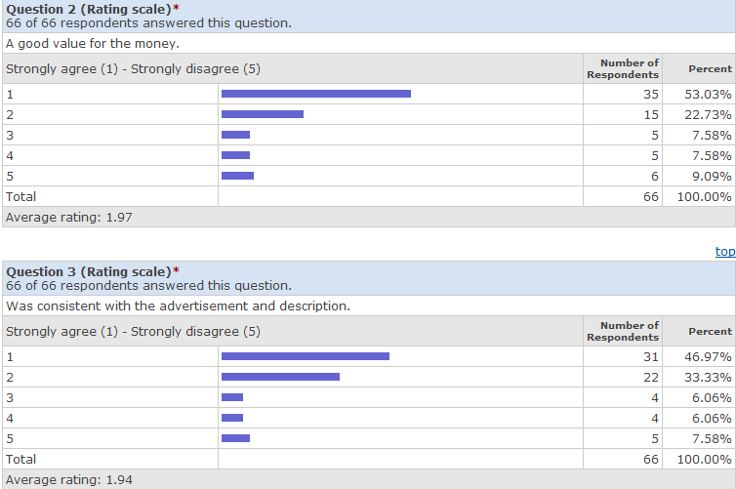
2-3. Event information

Slide 5
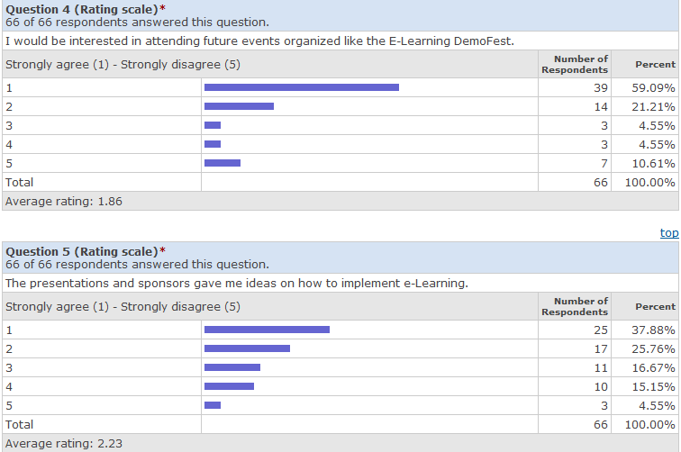
4-5. Event information

Slide 6
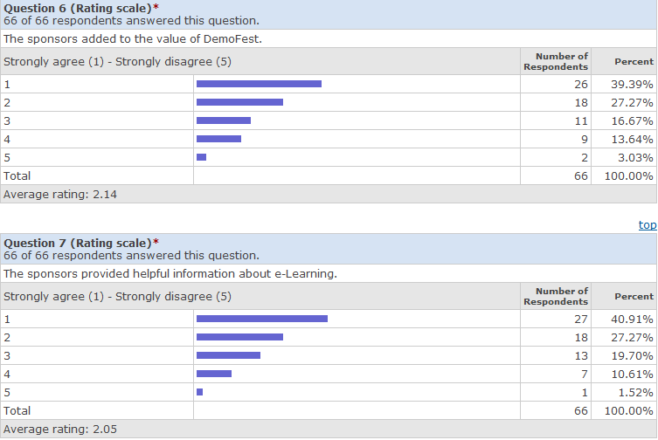
6-7. Sponsor information

