Slide 1
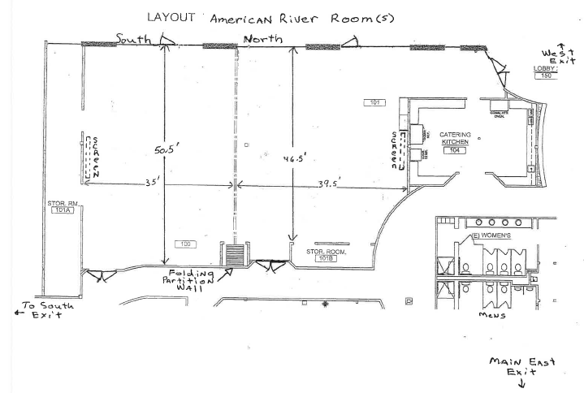
DemoFest 2011 Room Layout
4
3
2
1
Food
drinks
Skillsoft
Los Rios
5
Articulate
Registration
CSUS
Wiley
ASTD
6
10
7
8
9
Hallway
North

