Slide 1
What should we focus on? Our emerging hedgehog
What we are deeply passionate about
Our market analysis can clarify what we can be the best in the world at, by showing how we can differentiate from other organizations in this space.
What we can be the best in the world at
What drives our resource engine
Source: Jim Collins, Good to Great and the Social Sectors

Slide 2
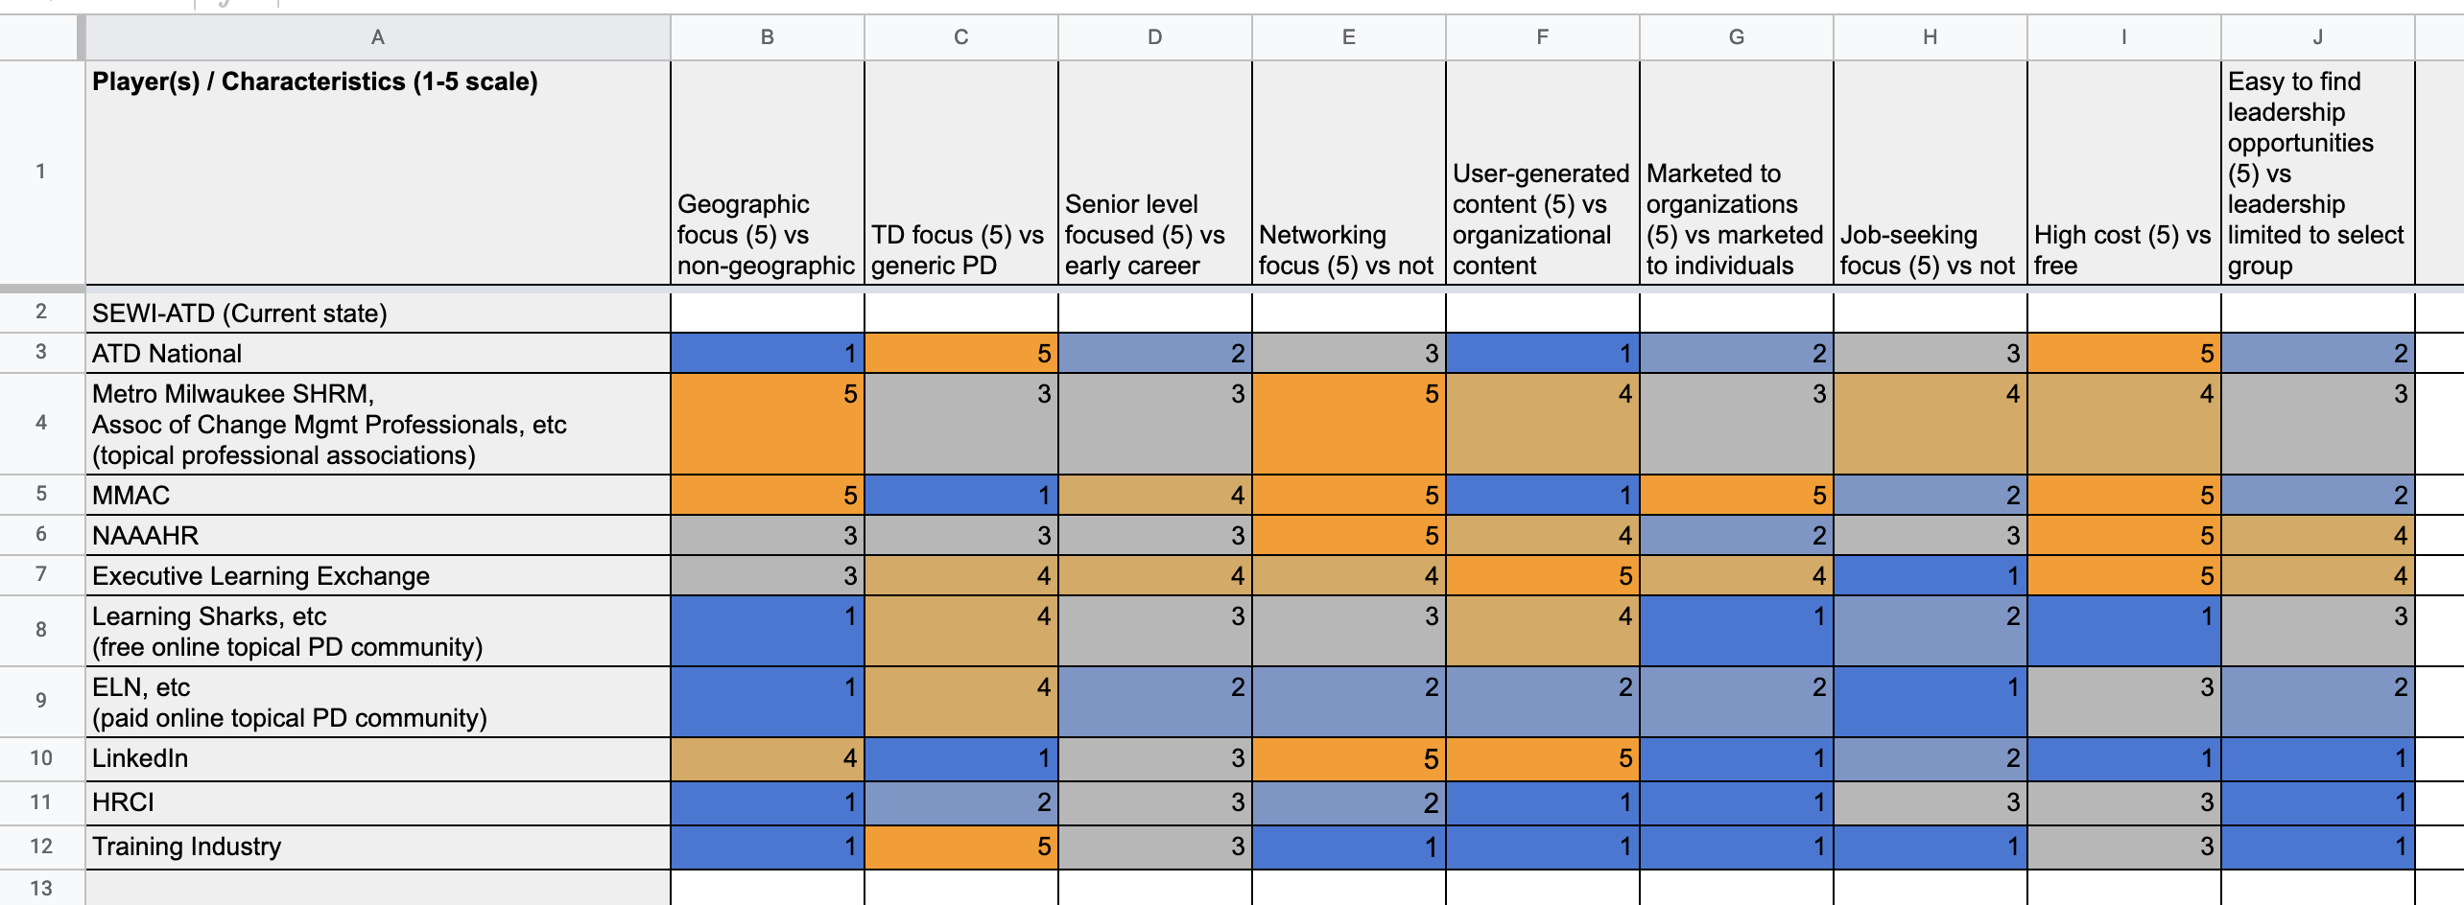
Mapping our current market
Source: Board planning July-August 2021

Slide 3
Our market comparison identified two clusters of players
Talent Dev Organizations
Regional Organizations
* K-means analysis revealed a third cluster (ELE, LinkedIn, and Learning Sharks)
Source: Board planning July-September 2021; K-means analysis; PCA analysis

Slide 4
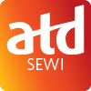
Two key contrasts with other TD organizations
ATD National, ELN, Training Industry, HRCI, ELE
SEWI-ATD Contrasts
❷
❶ Leveraging our community, specifically in SE Wisconsin
❷ Creating opportunities for members to lead and share their experience
❶
Source: Board planning July-September 2021; K-means analysis; PCA analysis

Slide 5
Three key contrasts with other regional organizations
MM-SHRM, MMAC, NAAAHR
SEWI-ATD Contrasts
❷
❶
❶ Focusing on the talent development profession
❷ Providing leadership opportunities at the early career level
❸ Being affordable
❸
Source: Board planning July-September 2021; K-means analysis; PCA analysis

Slide 6
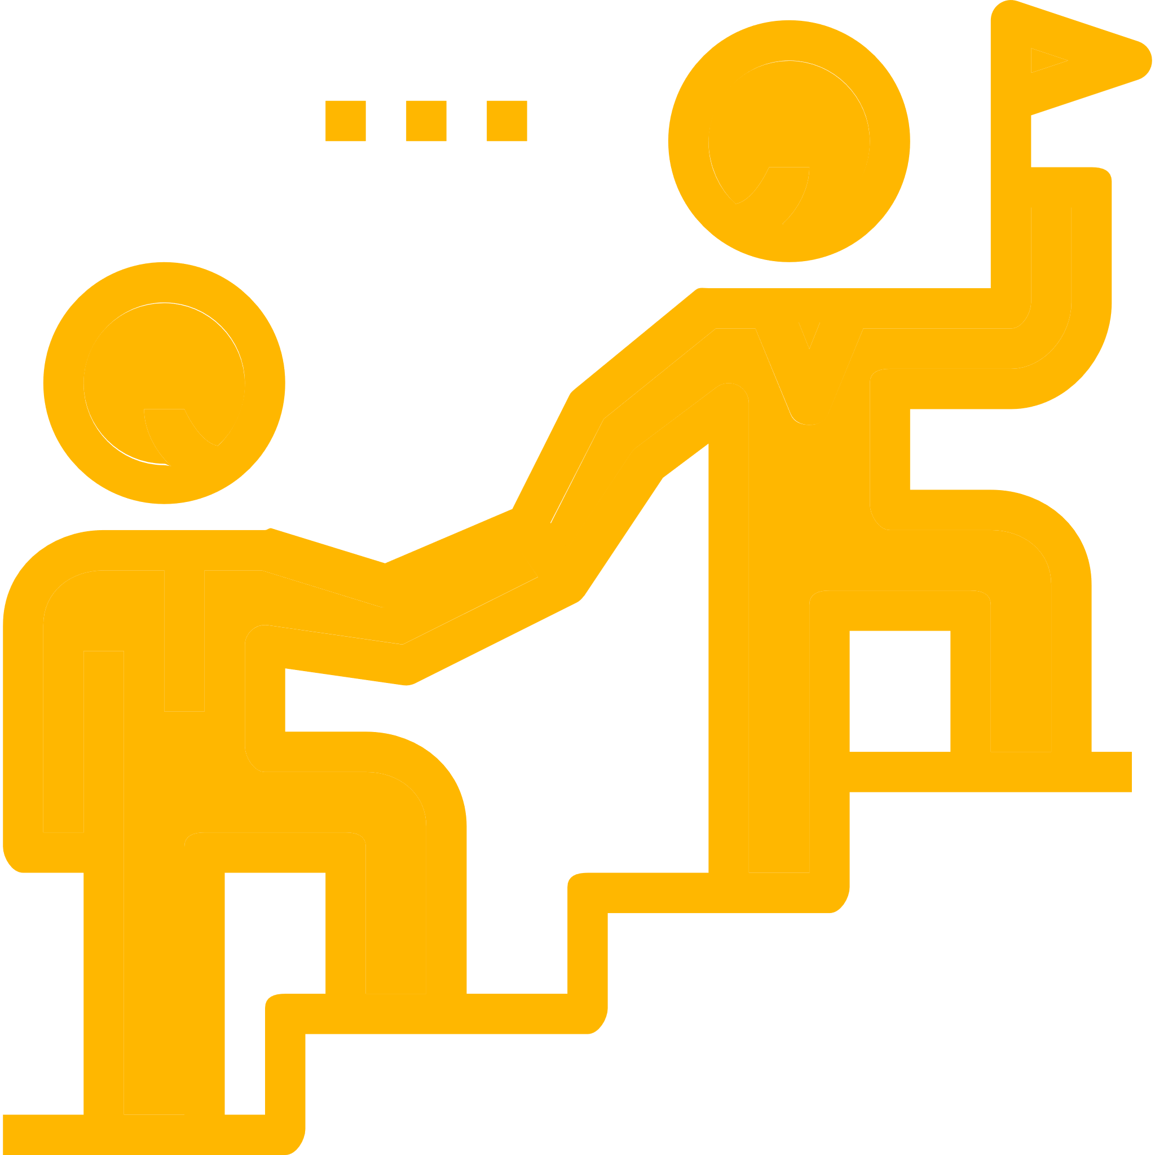
These contrasts identify three pillars for our hedgehog
Focusing on the talent development profession
Leveraging our community, specifically in SE Wisconsin
Creating opportunities for members to lead and share their experience
Providing leadership opportunities at the early career level
Talent Development Upskilling
Belonging in our Professional Community
Early-Career Leadership Opportunities
(while still being affordable)

Slide 7
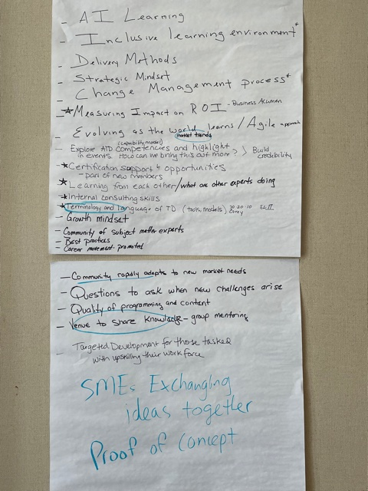
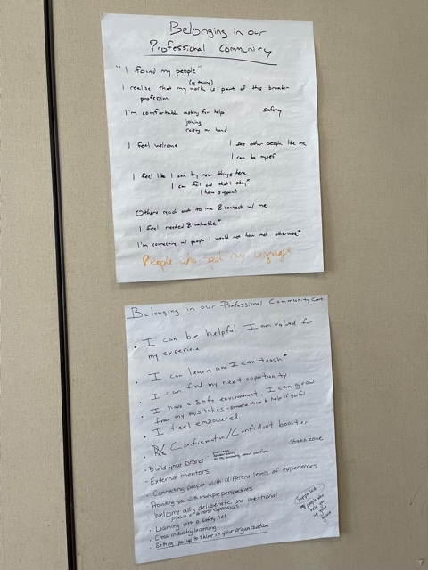
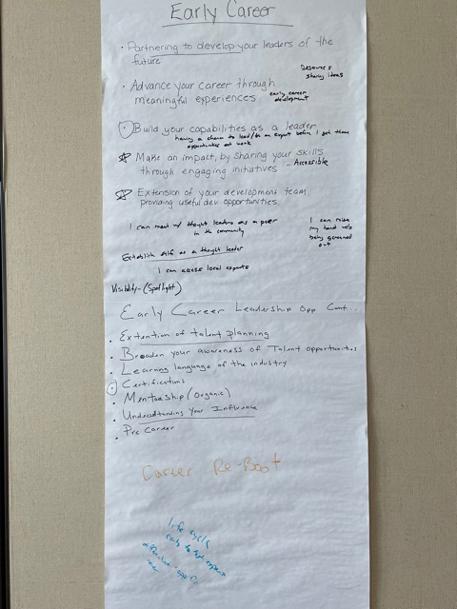
How do we talk about these pillars?
Source: Board strategic planning session, September 2021

