Slide 1
How to Engage Senior L&D Corporate Leadership in Your Local Chapter: Launching a Leadership Council
ASTD Houston
Debbie Richards, President
Margaret Maat, Special Projects Coordinator

Slide 2
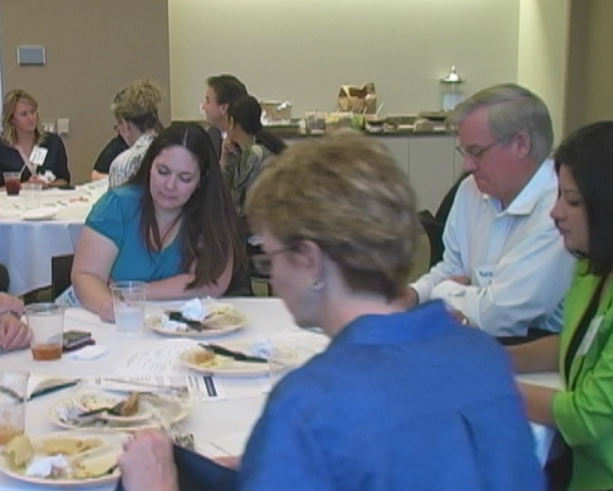
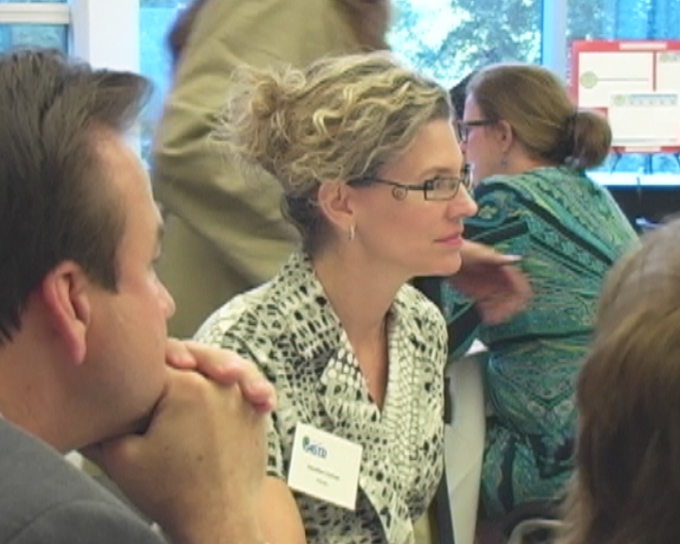
Have L&D Executives Involved in Your Chapter!

Slide 3
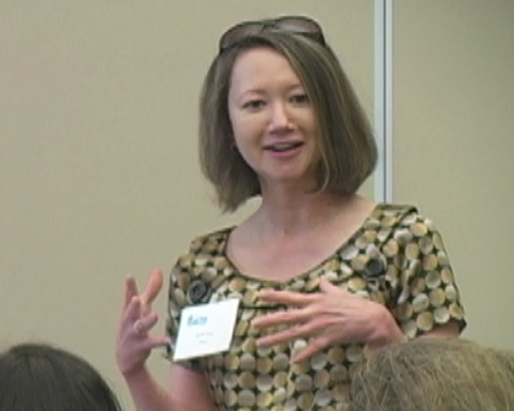
Janet True, Talent Development, Global Construction
Fluor Corporation
Winner of ASTD’s BEST award in 2012

Slide 4
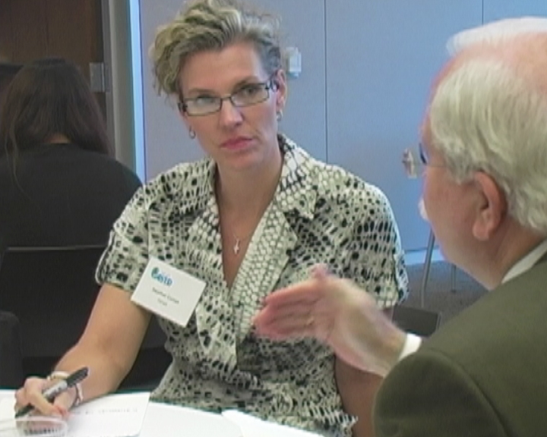
Heather Curran, Director, Training & Development
Hines, International Real Estate company with $24 billion in assets

Slide 5
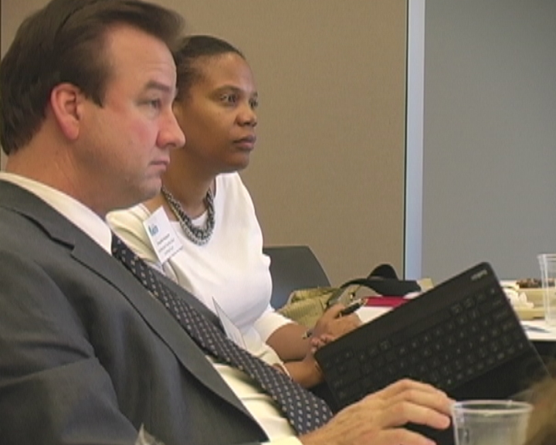
Kent Nuttall, Curriculum and Programs Manager, Client Learning Services
Baker Hughes, Oil services firm with 58,000 employees in 80 countries

Slide 6
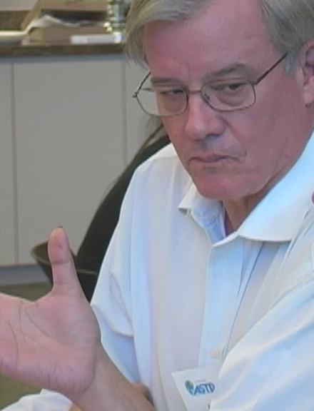
Mark Corson, Learning Center Manager
Royal Dutch Shell
Developing the global strategy for Shell Learning Centers
Designing new learning centers in Canada, Brazil, and Iraq

Slide 7
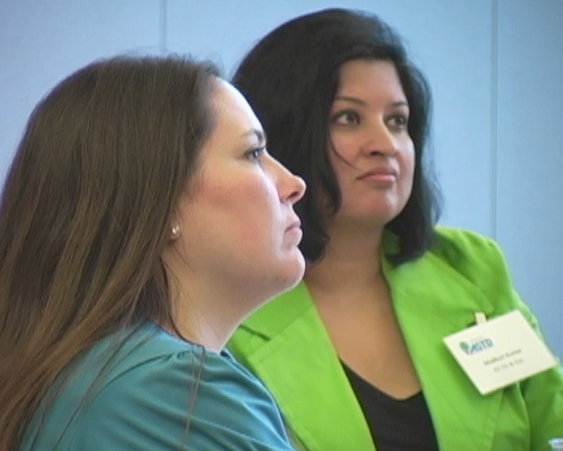
Jennie Flemmons, National Oilwell Varco
Madhuri Kumar, GE Oil & Gas

Slide 8
Our Partners in Building Chapter Strategy

Slide 9
Background

Slide 10
Strategic Goals
Build ASTD Houston’s brand.
Connect members and the community.
Create opportunities for members to serve. (mentoring, volunteering, community service)
Maintain financial accountability/growth.
Increase value to memberships and promote growth.

Slide 11
Chapter Goals
Ensure the number of joint memberships meets the 40% Chapter Operating Requirement (CORE).
Communicate with chapter members several times each month via the website, newsletter, email, and social media.
Support the initiatives and programs of other ASTD chapters and ASTD national programs.

Slide 12
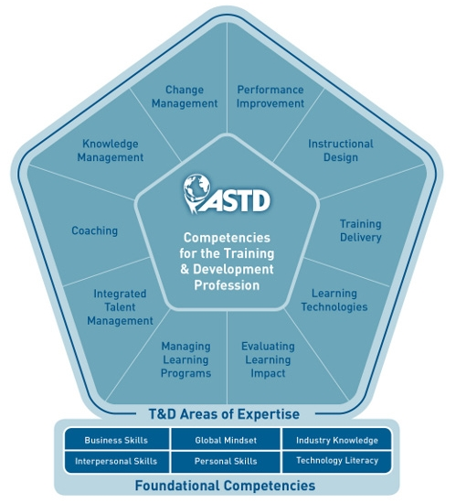
Events/Professional Development
We currently model our events and professional development events around the ASTD Competency Model.
The model identifies the roles, areas of expertise, and foundational competencies for professionals in the learning and performance field.

Slide 13
Home to the World's Fastest Growing Companies
Houston is home base for many of the world's top companies.
We're third only to New York and Chicago in the number of Fortune 500 headquarters.
Our popularity isn't limited to domestic businesses: of the world's 100 largest non-U.S. based corporations, 66 have a presence in Houston.

Slide 14
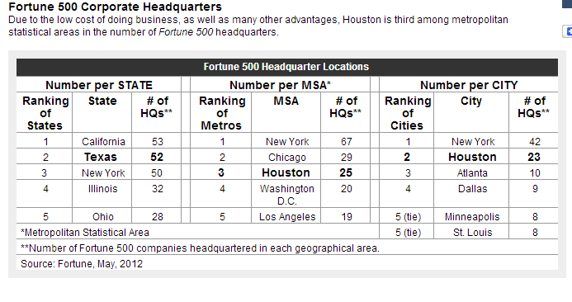

Slide 15
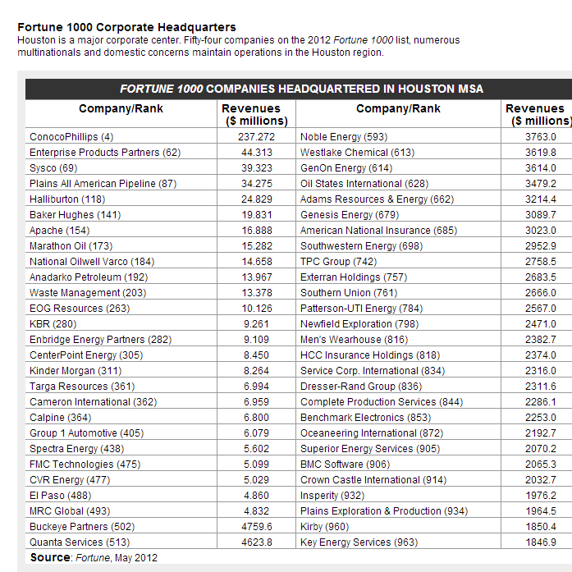

Slide 16
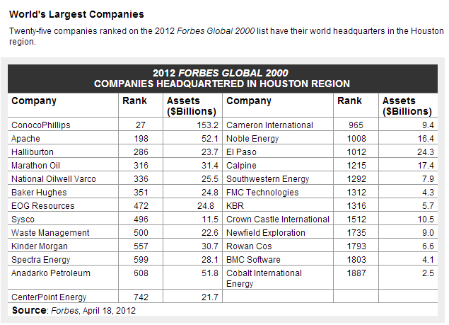

Slide 17
How Can We Attract These Companies?
Build the Houston ASTD brand and community.
Get leadership involved – have them help set direction and growth of the chapter!
Grow membership.

Slide 18
How We Found Them
LinkedIn
Houston Business Journal
Local and Regional Professional Networking Events
National ASTD Events

Slide 19
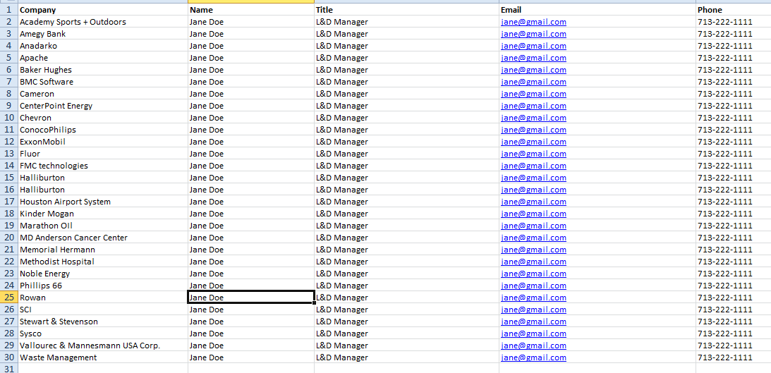
We Created a Target List

Slide 20
Application Exercise
Analyze your membership and your regional market.
What is your ratio of consultants to corporate members?
Are you attracting corporate leaders?
What are the major companies in your region? How do you find them?
Work in table teams to complete #1 on the Handout

Slide 21
What is the Leadership Council?
A select group of L&D leaders who work in the corporate sector who act as advisors to our chapter in setting strategy.
It also provides an excellent opportunity for networking/sharing of best practices among other L&D leaders in the Houston market.

Slide 22
Details
ASTD Houston works with local L&D leaders to ensure that our programs are strategically aligned with the professional development needs of their employees.
We get input and suggestions for improvement in the areas of membership, events, conferences and professional development.

Slide 23
Sponsors
No cost to attend lunch meeting
Sponsors to pay for the lunch and location fees
Allow them 15 minutes for presentation

Slide 24
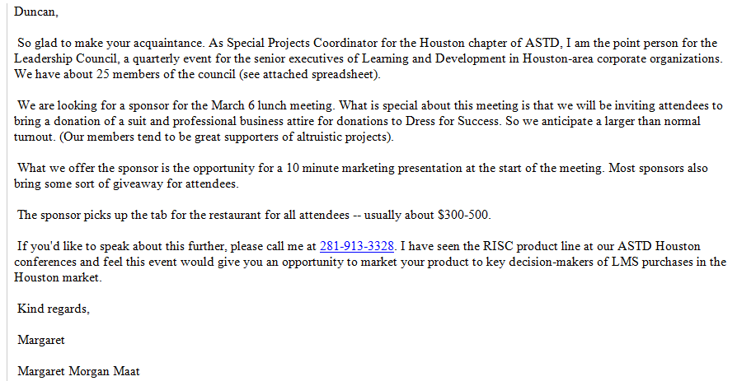

Slide 25
Advertisements
Not publicized on the calendar or mentioned at meetings.
Leaders commit time to attend the quarterly luncheons (1.5 hours ).
Sent out personal emails and called participants.

Slide 26
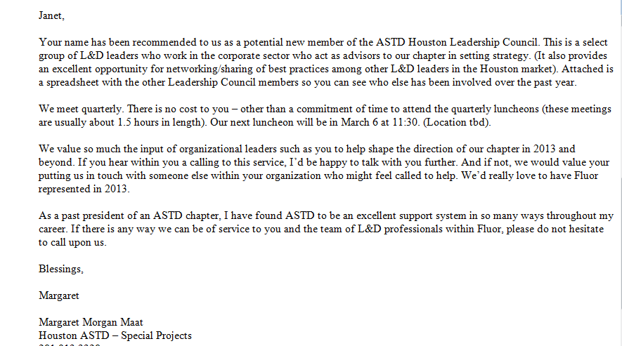

Slide 27
New Board Position Special Projects Coordinator
Function goals:
The purpose of the Special Projects Coordinator is:
To support the other functions and committees/teams in achieving the 2013 goals of the organization
To act as a resource for the Chapter President to implement special initiatives
To plan and implement 4 Leadership Council meetings per year

Slide 28
New Board Position Special Projects Coordinator
Goals for 2013:
Increase attendance at Leadership Council members by 25%
Recruit 3 new members for the Leadership Council
Implement a process for involving 3 key Leadership Council members as a “planning team” for the group
Improve Leadership Council sponsor satisfaction ratings
Implement a process for tracking effectiveness in leveraging Leadership Council influence to increase membership and increase participation in chapter events
Establish a baseline and then improve Leadership Council satisfaction ratings
Support the chapter president and leadership team in making measurable progress towards the successful implementation of the Next Level Planning document steps/criteria.

Slide 29
Our Value Proposition
Here’s what our Leadership Council Members have to say about the value the receive from involvement on the council.

Slide 30
Other Testimonials
The Leadership Council has been an effective way to network with other executives. This is a cost effective method to experience information regarding current technology, solutions to situational problems, and potential business issues in my industry. Expectations met: • Variety of industries represented that have similar business issues • Opportunity to share solutions • Meet other leaders with personal growth focus • Speaker that are relative to today’s market • Start and stop on time • Food – always food It’s a pleasure to be involved in the ASTD Houston Leadership Council. _________________________________________________________________________ Sarah E. Hurst Stewart & Stevenson Training Manager

Slide 31
Other Testimonials
Put Baker Hughes quote from Kent here (coming from Tiffany)

Slide 32
Application Exercise
Write out value proposition for involvement in your chapter’s Leadership Council
Work in table teams to complete #2 on the Handout

Slide 33
Our Progress

Slide 34
First Meeting
First meeting was 5/23/12.
Looked to our membership/board for the first invitees.
Corporations
Over 1000 employees
Members of Houston ASTD chapter
Included board members

Slide 35
Companies
Company Names
CenterPoint Energy | Memorial Hermann | ExxonMobil
Waste Management | MD Anderson Cancer Center | Chevron
Academy Sports & Outdoors | Methodist Hospital | Apache
SCI | Baker Hughes | Phillps 66
Fluor | Marathon Oil | Shell
Amegy Bank | Stewart & Stevenson | Halliburton

Slide 36
Conversations
Brought up that some corporate professionals in the past have been put off by feeling they were being “sold” by consultants; not so much a current problem but need to reclaim those who left from past experiences.
Tech Conference – Develop offshoot Forums…begin a Pilot Project Special Interest Group (“SIG”) that could take on a specific subject from the tech conference and develop over 2 – 4 months. Could also start a consultant SIG for the rest of the year

Slide 37
Other Conversations
Like general meetings but also mixers where can socialize and share ideas; build in more social opportunities in larger functions
Alternate meeting times – lunch, dinner (younger people have commitments after work)
Have reasonable priced Professional Development Events in afternoons

Slide 38
Other Conversations
Have a Lunch and Dinner on same topic; also broadcast as synchronous or asynchronous
Clearer message of WIIFM re. membership – how will it make doing my job easier, networking easier
HRD students- ASTD could teach for a graduate program- real world application

Slide 39
Second Meeting
Second meeting held 8/22/12
Attendees included:
MD Anderson
Amegy Bank
Stewart & Stevenson
Phillips 66
Settlement Facility Dow Corning Trust

Slide 40
So You Want to Be the Director of Learning?
Young people don’t know how to move up in the corporate training world, and they may not think about strategic planning.
The panel will discuss succession planning and mentoring/ learning.

Slide 41
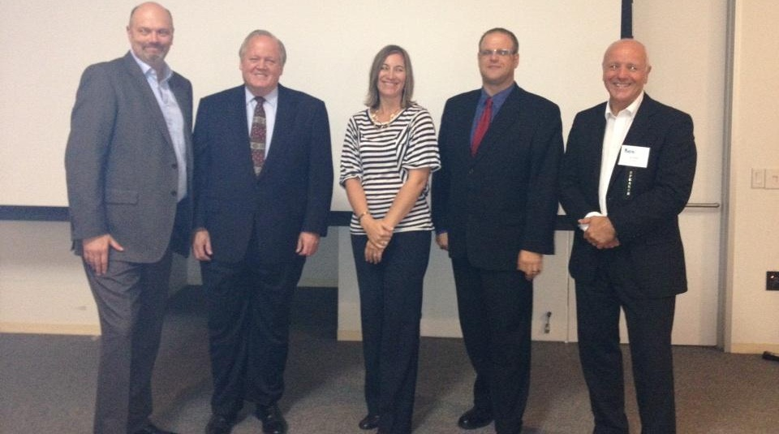

Slide 42
Third Meeting
Third meeting held 12/12/12.
Thank you and recognition of 2012 board.
Introduction of 2013 board members and their initiatives.

Slide 43
Discussions - Corporate Membership
At some companies, they only pay for two professional memberships. The fact that national isn’t bundled with local is a problem.
Advocates using stories about the value ASTD has brought to engage entire teams of L&D professionals within organizations to commit to membership as individuals.

Slide 44
Outcomes
Reviewed our membership policy and made changes
Charles Alvarez – got team membership for his entire staff at SCI
Started encouraging sponsors to partner up with a corporate client to make “commercial” more relevant – tell the story of how you partnered to create value for the client

Slide 45
Spring 2013 Meeting
Invited L&D leaders from Fluor and Jiffy Lube University.
March “Dress for Success” drive
Topics include: Technology Conference and upcoming programs
Did a table discussion of Ram Charan article on Strategy

Slide 46
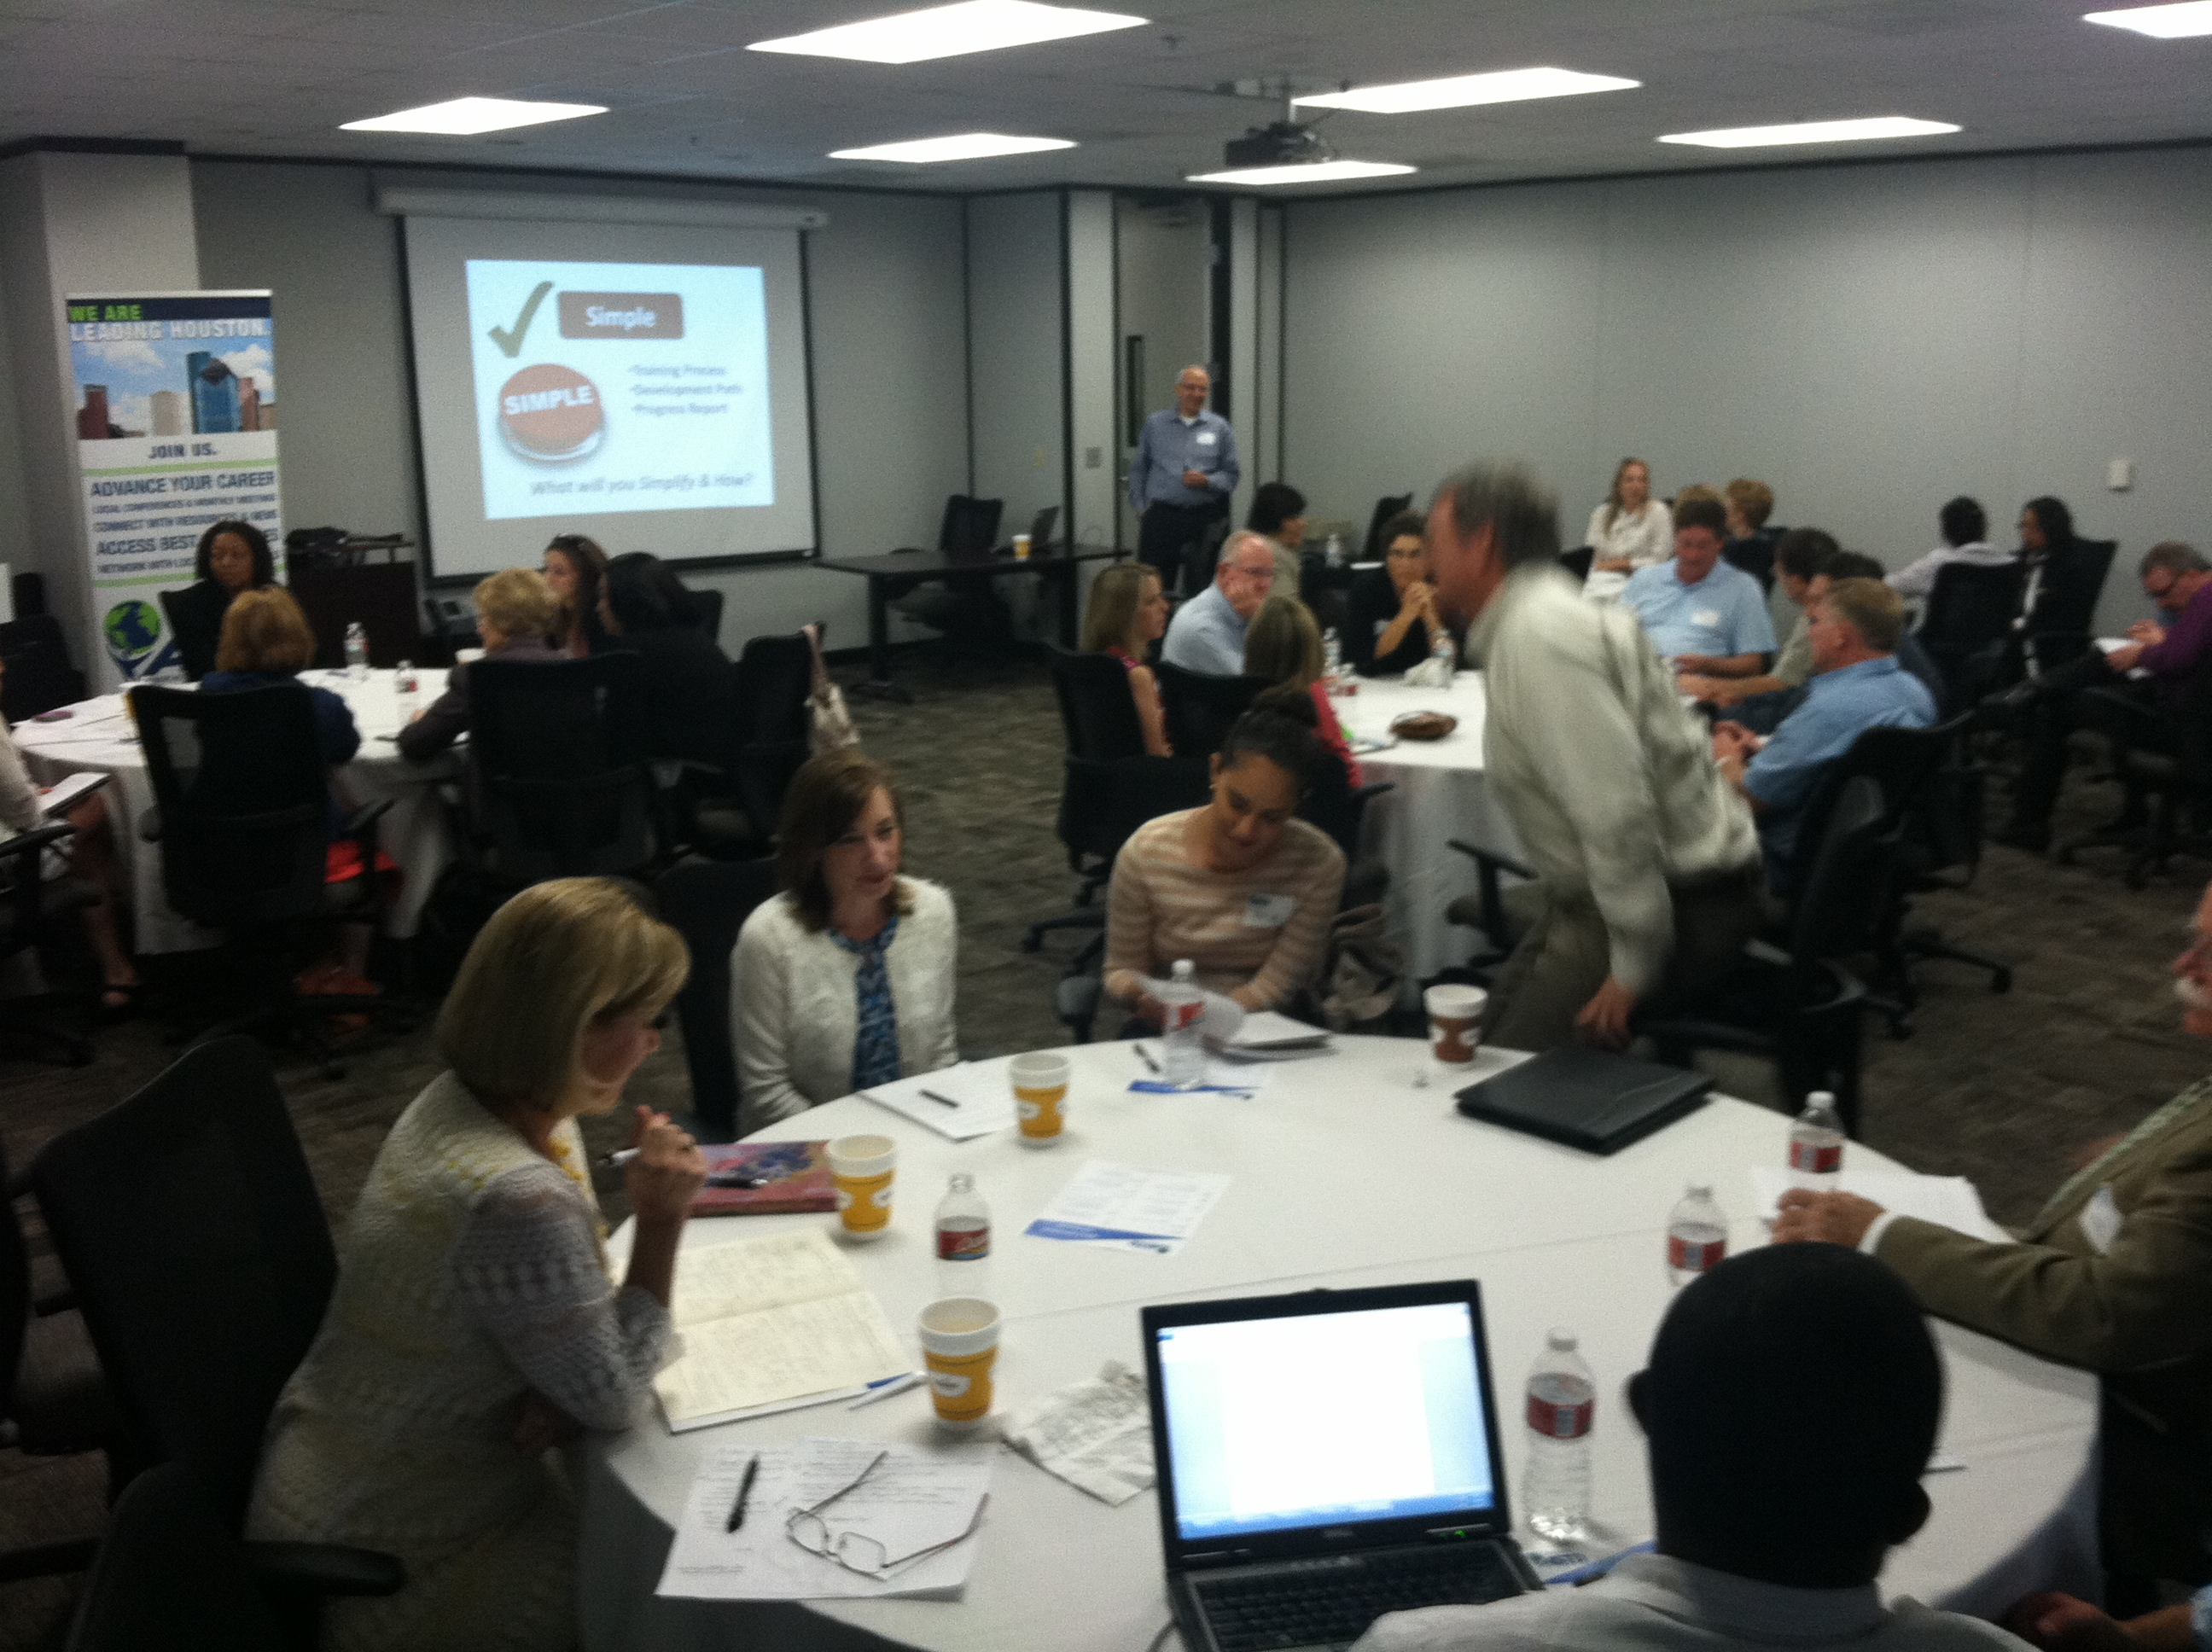
August General Meeting Jiffy Lube
SRO – over 50 attendees!

Slide 47
Outcomes
Theme of Annual Conference: Running Your L&D Organization Like a Business
Corporate executives spoke at our conference (VP level keynote plus 5 out of 13 breakout facilitators)
Better representation of L&D execs as attendees.
David Bell, of Amegy Bank, brought his entire L&D team to the conference

Slide 48
Fall 2013 Meeting
Focused on Employee Learning Week
How to leverage it within their organizations
How they could help us promote it to larger Houston business community

Slide 49
Application Exercise
What are the issues you’d like Executive L&D input on?
Work in table teams to complete #3 on the Handout

Slide 50
Getting Started

Slide 51
Checklist
Page 2 of Handout

Slide 52
The ASTD Team
Create a committee to:
Coordinate the invites and keep up with council members
Scout sponsors and locations
Set the agenda
Follow through with suggestions and report back to the council

Slide 53
Sponsors
Ask existing sponsors first.
Look for sponsors who can’t afford a larger contribution.
Stress the fact that they will be able to have an intimate conversation with decision makers.

Slide 54
What Have We Learned?
Board level position
Introductions – what they learn from each other
What are you most proud of?
What is the most important competency you’d like your team members to develop?
Sponsor – who makes a good one; we had a corporate sponsor last meeting
Quality of meeting space (restaurant vs. company space)

Slide 55
And always ….
Report back to the board.
Follow through with suggestions and ideas; report back to the council on what you have done with their suggestions
Embrace the knowledge, support and community that you will get by working with the council.

Slide 56
Moving Forward
We’ve set up a LinkedIn group
Check back in
Can help you do detective work
What are you going to do in next 30 days? And how can we help?
Work in table teams to complete #4 on the Handout

