Slide 1

Sample Social Media Posts

Slide 2
When You Earn the Credential
I’m excited to share that my hard work has paid off and I have earned my #CPTD credential!
Thank you to [@insert person] for supporting me through the #CPTD certification process. I couldn’t have done it without you!
Today I officially join the #CPTD community. I look forward to sharing ideas with and learning from this talented and dedicated group of TD professionals!

Slide 3
About the Credential
What does having the #CPTD credential mean to me? It shows my commitment to the #TalentDevelopment field. And it is a promise to my current and future learners that I will continue to develop myself so that I am better equipped to help you.

Slide 4
Posts During Your Continued Professional Development
Just as the #CPLP has continued to evolve and is now the #CPTD, so too will I, as I continue to develop professionally, and focus on my ability in all 23 capabilities of the Talent Development Capability Model. td.org/capabilitymodel
Fellow #CPTDs – What are you doing to earn continuing education units in the new content areas for recertification? I’m attending [insert webcast or LinkedIn Learning course (etc.) you are attending].
Have you taken the self-assessment on the Talent Development Capability model? I have and will be focusing my professional development on [insert capability from the model]. #NeverStopLearning www.td.org/capabilitymodel

Slide 5
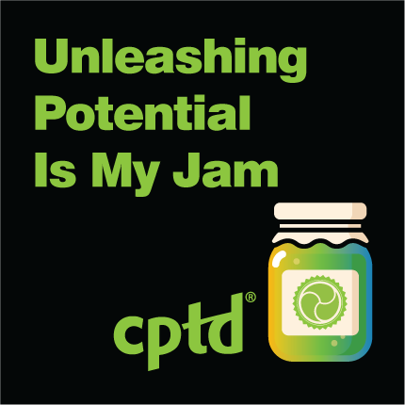
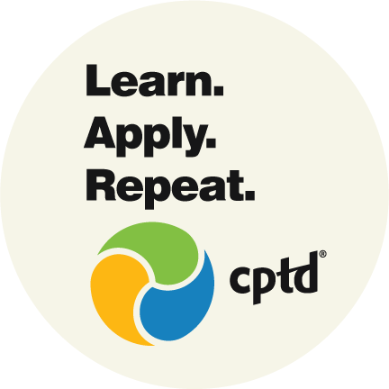

Posts Just for Fun
Use these images to share what talent development means to you.

Slide 6
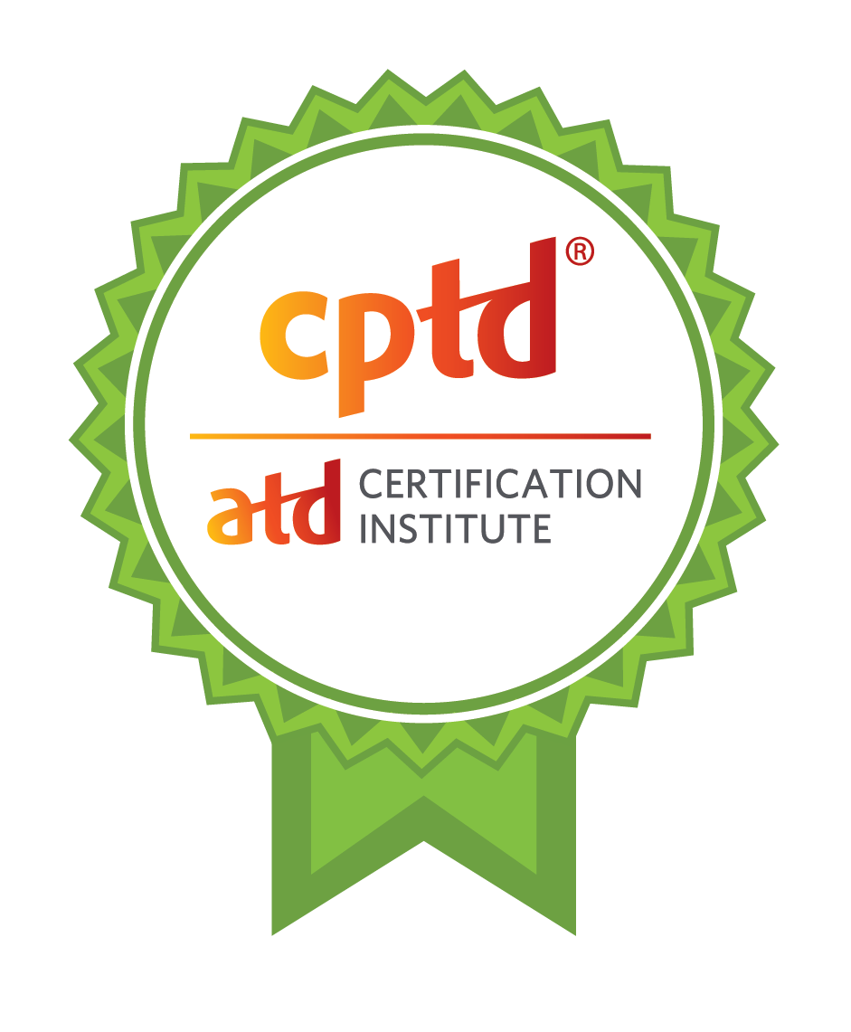
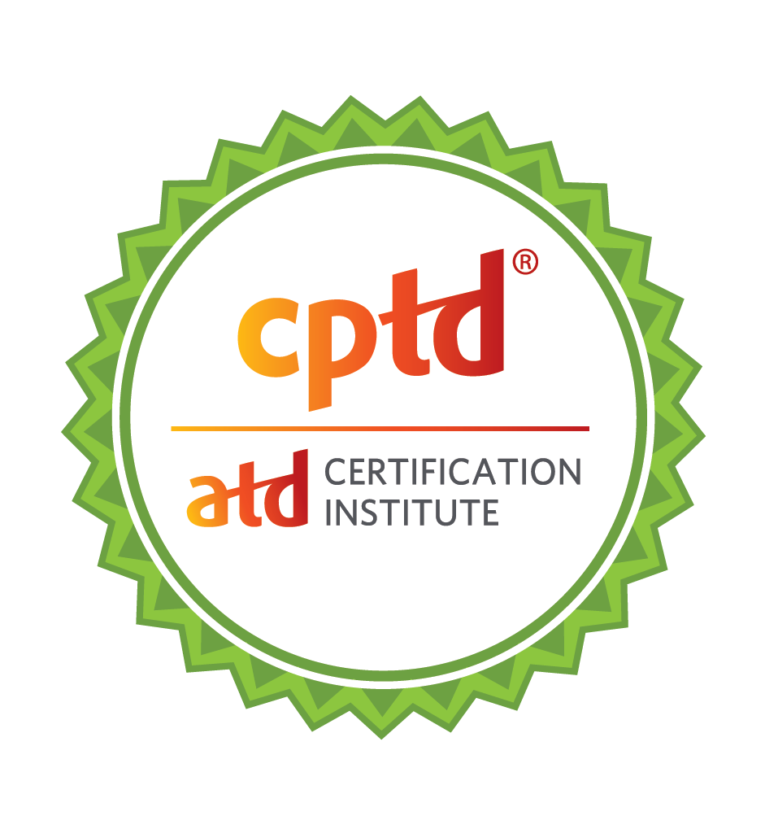


Additional Images to Use
Or, a photo of your certificate when it arrives/your digital certificate.

Slide 7
Please @ Us!
We would love to join the conversation. When posting, please feel free to @ us using the below handles.
If posting on Twitter, use @ATD
If posting on Facebook, use @ATD
If posting on Instagram, use @atdnational
If posting on LinkedIn, use @Association for Talent Development (ATD)

