Slide 1
2022 Chapter Recruiting Guidelines

Slide 2
2021 ATD Board of Directors
President
NAME
President-Elect
NAME
Past President NAME
Secretary NAME
Admin Assistant NAME
VP Programming NAME
VP Finance NAME
VP Brand & Technology
NAME
VP Membership
NAME
VP Professional Development NAME
Director of Programming NAME
Director of Partnership OPEN
Director of
Technology NAME
Director of Brand Meray Kim
Director of Member Experience / CARE NAME
Director of
Professional Development NAME
Director of Programming
NAME
Director of
Speaker Connections NAME
Director of
Career Resources NAME

Slide 3
2022 ATD Board of Directors
President
NAME
President-Elect
NAME
Past President NAME
Secretary NAME
Admin Assistant NAME
VP Programming NAME
VP Finance OPEN
VP Brand & Technology
NAME
VP Membership
NAME
VP Professional Development NAME
Director of Programming NAME
Director of Partnership OPEN
Director of
Technology NAME
Director of Brand OPEN
Director of Member Experience / CARE NAME
Director of
Professional Development OPEN
Director of Programming
NAME
Director of
Career Resources NAME
Open position
Director of
Speaker Connections OPEN
New to their role or team
Revised 00.00.20XX

Slide 4
Why does this matter?
Engagement is everyone’s business.
The turnover of volunteers (in any organization) is about 50 percent on average, which means there are always openings.
Our board saw a X% turnover in 20XX
Only X% were retained for 20XX
Every position that saw turnover in 20XX is either open or filled by a brand-new board member in 20XX. #recruitingmatters.
The average time of service from new members (##) in 20XX was, X months
Every VP in 20XX felt the pressure to take on their team’s duties instead of focusing on leadership and strategy.
#1 reason given for lack of participation was, BLANK.
Board meeting attendance averaged XX% in 20XX.
X% of those not in attendance were our newest board members (OR OTHER STAT).

Slide 5
It’s not my Chapter, it’s YOUR chapter
Member engagement is a direct reflection of our board engagement.
With busy lives, it can be hard to find time to volunteer.
However, the benefits of volunteering can be enormous.

Slide 6
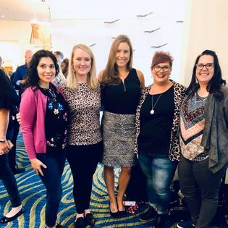
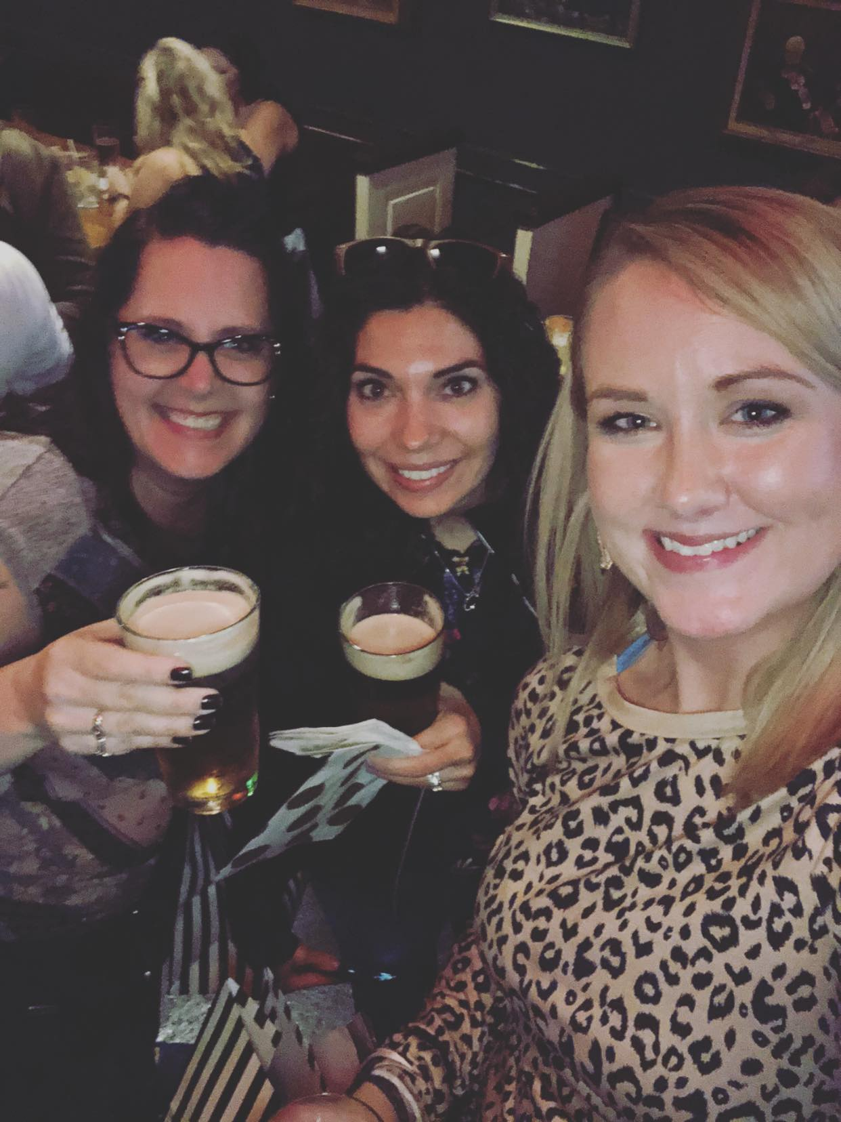
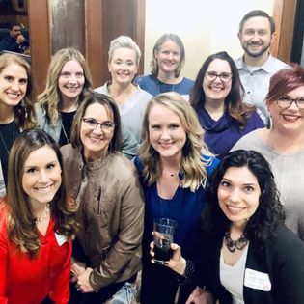
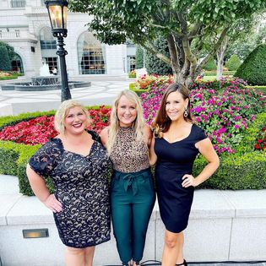
Benefits of Volunteering
Share your story and successes! #alwaysrecruiting
Volunteering allows you to connect to your community and make it a better place.
It’s good for your mind and body.
It can benefit you and your organization as much as it does your chapter.
Can advance your career.
Helps you make friends, expand your network, and boost your social skills.

Slide 7
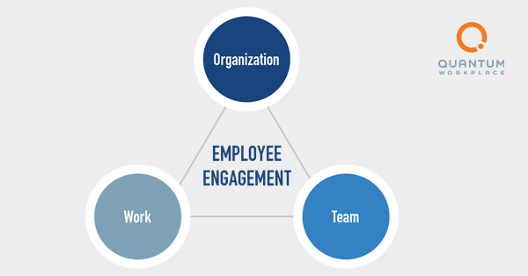
What do we look for in a volunteer?
Being in the Talent Development field isn’t all that matters.
Commitment
Time
Support
Reliability
Engagement

Slide 8
Final Thoughts
Before they can begin their service, we have to ensure they’re set up for success.
Meet the President & President-Elect
Confirm support from their employer.
Fill out Board Application
Fill out Bio
VPs must be National Members, Directors do not.
Attend monthly board meetings

