Slide 1
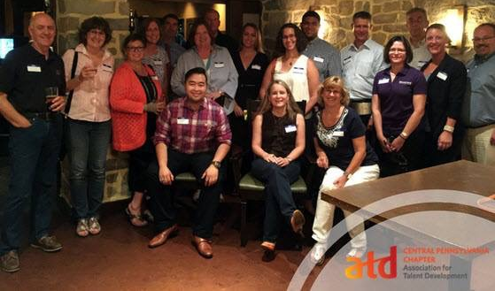
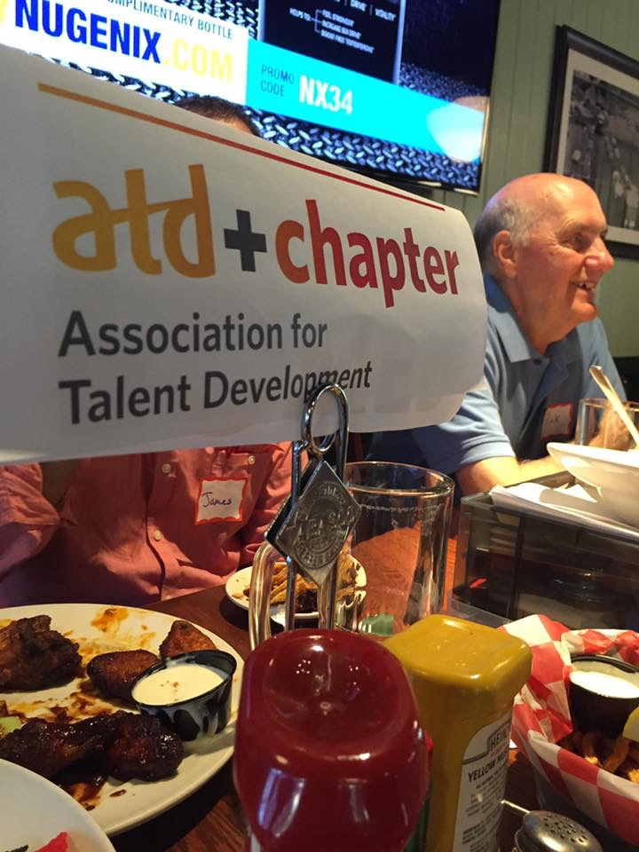
Marketing Team
The Marketing Team:
Designs and Distributes the Event Watch
Designs and Distributes the Newsletter
Publicity of events through social media
Design of promotional materials
Promotion of Employee Learning Week
"It's an opportunity to get members engaged with all of the great learning and networking events offered by the chapter"
"A great experience working with the diverse membership of the chapter"
"What I've learned on the committee helps me to promote learning at my workplace"

