Slide 1
ATDCFL 2023
Monthly Meeting
April 18, 2023
Notes:
Call to order: Zizo Aku, President called the regular board meeting of the ATD Central Florida chapter to order on 18 April 2023 at 7:##pm.

Slide 2
Agenda
Welcome
Roll Call
Approve Previous Minutes
Chapter Health Metrics
Actions Tracker
Review Event Calendar
Plan for Upcoming Events
Vertical 30/60/90 Reports
Wrap Up

Slide 3
Roll Call
Attendance (Green = present, Yellow =absent & Teal = vacant) | President: Past President: VP of Engagement: VP Membership: VP of Finance: VP Programs Operations: VP of Chapter Operations: VP of Strategic Partnerships: Director of Chapter Operations: Director of Certification Programs: President-Elect: VP Programs: VP of Communications: Director of Communications: Director of College Relations: Director of Membership: Director of Sponsorship: Director of Social Media:

Slide 4
Approve March Board Meeting Minutes
The motion to approve the Minutes was called by ### at 7:## and was approved.

Slide 5
The Board
Notes:
Meetings
Cadence
2 hour
Additional meeting
Structure
Robert’s Rules of Order
Roles and actions
Reports
Future actions/What help do you need?
Board Recruiting Process
Board member vetting
Accountability

Slide 6
Creating Events
Process
Speaker Vetting

Slide 7
Emails to Members
Type
Cadence
Corrections

Slide 8
Finance
2023 Budget

Slide 9
Resources for Chapter Leaders
https://www.td.org/chapters/clc
Notes:
@scott - Since we are actively recruiting and onboarding new leaders, we should keep these resources slides for all meetings. We can always skip them when we don’t have new people.
https://www.td.org/chapters/clc

Slide 10
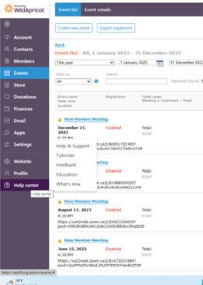
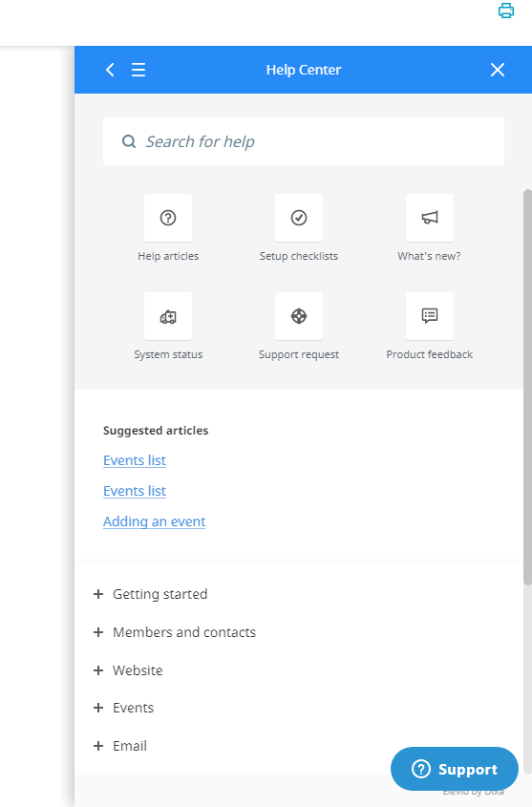
Personify aka Wild Apricot
Notes:
https://atdcfl.org/admin

Slide 11
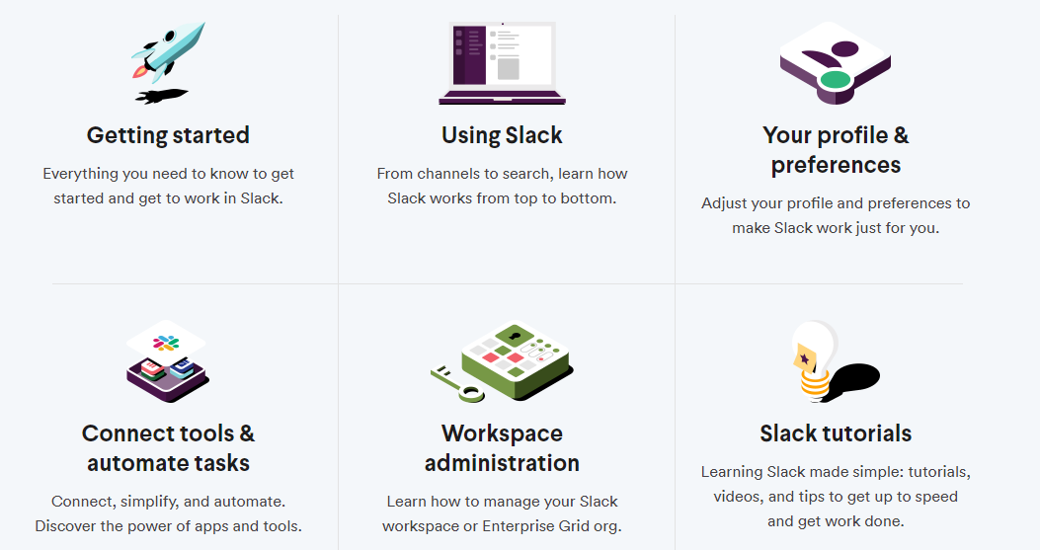
Slack Best Practices
Make sure you are replying to correct message thread
Tag people who need to respond/see your message.
Check Slack every 1-2 days for anything you may have missed
When creating new channels related to chapter internal business/activities - make the channel private.
https://slack.com/help
Notes:
https://slack.com/help

Slide 12
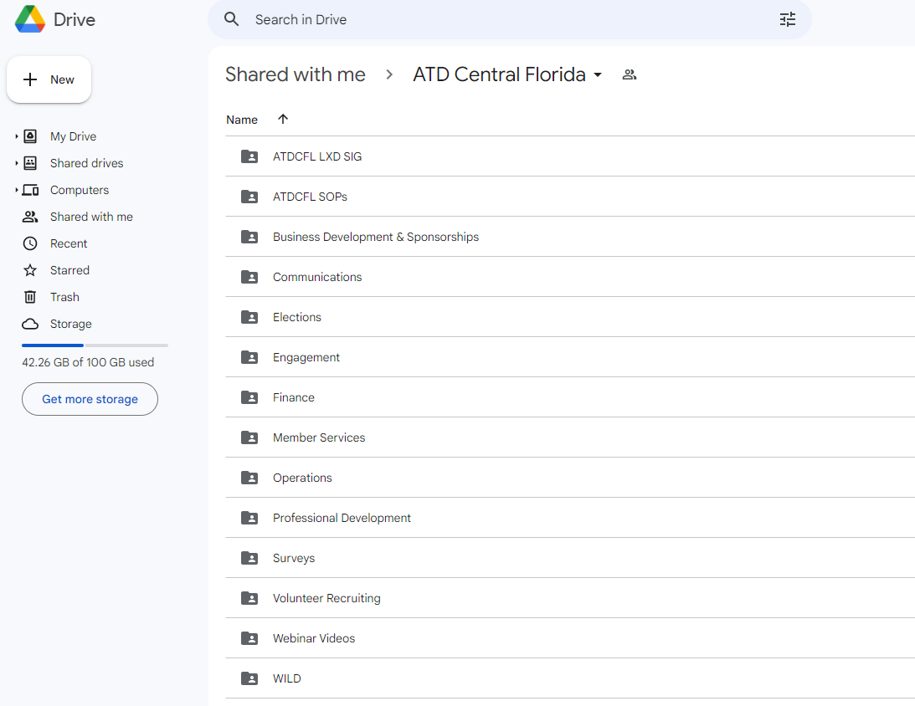
Google Shared Drive
Document storage
SOPs
Historical
Google forms
Volunteer Interest
Speaker Interest
Notes:
https://docs.google.com/spreadsheets/d/1rIxnO03_tVjrP9_OlhZrXwXIfVgFkna2hq306tc4Xsc/edit#gid=62739618

Slide 13
2023 Goals and Key Results
Overall Goal #1
A1: Subgoal #1
A2: Subgoal #2
A3: Subgoal #3
2. Overall Goal #2
B1: Subgoal #1
B2: Subgoal #2
B3: Subgoal #3
3. Overall Goal #3
C1: Subgoal #1
C2: Subgoal #2
C3: Subgoal #3

Slide 14
Chapter Status

Slide 15
Chapter Health Metrics: Chapter Membership

Slide 16
Chapter Health Metrics: Renewals by Month

Slide 17
Chapter Health Metrics: Average Event Participation

Slide 18
Financial Report
Review Monthly Financial Documents.
Profit and Loss for March:
March Net Income:
Net for 2023:
Current Assets: $

Slide 19
Review CARE Metrics

Slide 20
After Action Review for Events in the Last 30 Days
Goal is to capture a quick synopsis, positives/sustains, and improvements for the
future for EACH event to improve long-term chapter operations.
Event #1 Date – Event #1 Title
Feedback
Event #2 Date – Event #2 Title
Feedback
Event #3 Date – Event #3 Title
Feedback

Slide 21
Event Calendar (NONE of these are on our site)
Date | Time | Duration | Type | Title | Presenter/Backup | Host
03/23/23 | 9:00 AM | 7 hours | Workshop - Face-to-Face | Gamification Certification Program | Jonathan Peters | Maria Rodriguez
03/30/23 |  |  | Webinar | Webinar
4/1 |  |  | Face to Face | ATDCFL Book Club |  | Walter Brown
4/10 - 4/14 | All Day | 4 Days | Conference Support | LSCON 2023 |  | Rosa & Maria
04/13/23 | 12:00 PM | 1 | Webinar | QStream tent. JS |  | P: A:
04/20/23 | 6:30 PM | 1 | Virtual New Member Orientation | New Member Orientation |  | Joanie
04/29/23 | 6:00 PM |  | ATD Social -with Sponsor |  | Sponsor Presenter | Maria Rodriguez
 |  |  | Face to Face | ATDCFL Book Club |  | Walter Brown
05/11/23 | 12:00 PM | 1 | Webinar | Barry Nadler |  | P: A:
05/31/23 | 7:00 PM |  | Webinar
 |  |  | Face to Face | ATDCFL Book Club |  | Walter Brown
06/08/23 | 12:00 PM | 1 | Webinar | Finance Literacy 101 | Cheryl Blackeney | P: A:
06/15/23 | 6:30 PM | 1 | Virtual New Member Orientation | New Member Orientation |  | Joanie
Notes:
Next 90 Days events -- NONE of these are on our calendar
3/23 Event is being cancelled -- rescheduled
3/30 Still TBD; Instructional design cohort?
Sync old calendar and new calendar
Remind Janet and Maria
Add columns for locations, website add

Slide 22
Individual Slides for Upcoming Events
Enter individual slides for upcoming events here outlining:
POC Responsible/Host
Actions Taken
Actions Pending
Support Needed

Slide 23
Upcoming Program - Fill in date/title/speaker and details below
Purpose:
POC:
Speaker:
Topic:
Capability Focus Area/s - Developing Professional Capability:
Actions Taken:
Actions Pending
Support Needed

Slide 24
Upcoming Program - Fill in date/title/speaker and details below
Purpose:
POC:
Speaker:
Topic:
Capability Focus Area/s - Developing Professional Capability:
Actions Taken:
Actions Pending
Support Needed

Slide 25
Upcoming Program - Fill in date/title/speaker and details below
Purpose:
POC:
Speaker:
Topic:
Capability Focus Area/s - Developing Professional Capability:
Actions Taken:
Actions Pending
Support Needed

Slide 26
Outstanding Action Items/Completed in Last 30 Days
Task | Complete? / Outcome | Owner/Vertical

Slide 27
Board Member Title (i.e. President, VP Finance, etc.)
Last 30 Days:
Next 30 Days:
Next 60-90 Days:
Support Needed:

Slide 28
Board Member #2 Title (i.e. President, VP Finance, etc.)
Last 30 Days:
Next 30 Days:
Next 60-90 Days:
Support Needed:

Slide 29
Board Member #3 Title (i.e. President, VP Finance, etc.)
Last 30 Days:
Next 30 Days:
Next 60-90 Days:
Support Needed:

Slide 30
Action Items
Task | Support Needed | Owner/Vertical

Slide 31
Open Discussion

Slide 32
Wrap-Up
Next Meeting: May 9
Notes:
#### made the motion at 8:## pm, seconded by ####. The motion was approved. The meeting was adjourned at 8:## pm.

