Slide 1
UnConference
a participant-driven event

Slide 2
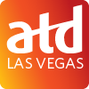
Monthly meetings – virtual meetings are free of charge
Special Interest Groups
Zero to Ten Coaching Platform – included with Chapter Membership
15% off Dale Carnegie Programs
15% off Remote Leadership Programs
Member Benefits + Membership Update
Notes:
Price changes from national
Members-only benefits

Slide 3
What exactly is an un-conference?
Notes:
any event where the agenda is set by those who attend
Each session is run by an attendee(s)
can take a whole range of different formats.
Any session can be amended

Slide 4
“the sum of the expertise
of the people in the audience
is greater than the sum of the expertise of the people on the stage”
Notes:
At any conference you attend...
Quote from entrepreneur Dave Winer
If you know our chapter, you know we have a great deal of expertise in Vegas
Many people here have presented at Chapter meetings
Today no keynote speakers have been invited, no panels have been arranged

Slide 5
UnRules of the UnConference
Whoever shows up are the right people
Whatever happens is fine
Any format is acceptable
Q&A, Show & Tell, Debate, Presentation, Discussion, etc.
Capability Model topic “areas”
Conversation-starting questions provided
Take breaks as you need them
Take responsibility for your own learning - you get what you put in
Notes:
We are going to set up breakout rooms, and you’ll have your choice where to start.
Whatever happens - be professional!
In case you get stuck - questions

Slide 6
Event Topic Areas
3 Topic Rooms:
Personal Capability
Communication, Emotional Intelligence and Decision-Making, Collaboration and Leadership, Cultural Awareness and Inclusion, Project Management, Compliance and Ethical Behavior, Lifelong Learning
Professional Capability
Learning Sciences, Instructional Design, Training Delivery and Facilitation, Technology Application, Knowledge Management, Career and Leadership Development, Coaching, Evaluating Impact
Organizational Capability
Business Insight, Consulting and Business Partnering, Organization Development and Culture, Talent Strategy and Management, Performance Improvement, Change Management, Data and Analytics, Future Readiness
Notes:
Should be here by 8:15-8:30

Slide 7
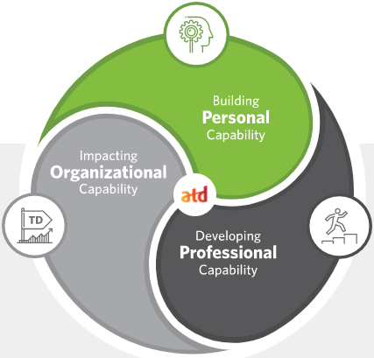
Topic: Personal Capability
Communication
Emotional Intelligence and Decision-Making
Collaboration and Leadership
Cultural Awareness and Inclusion
Project Management
Compliance and Ethical Behavior
Lifelong Learning
Need some help getting started? Try these discussion questions:
The capabilities in this category are often referred to as “soft skills” – but soft skills can be incredibly hard. What have you done as a Talent Development professional to support the organizations you work with (or for) in developing these skills?
Beyond classroom or other training programs - how do you, as a Talent Development professional, support skills within the realm of the personal capabilities?
We learned from the State of the Industry report that mandatory and compliance training typically accounts for 13.2% of an organization’s training. Does this seem to be true with the organizations that you work with (or for)? What role does Talent Development play in that learning? What strategies do you suggest using to ensure that the learning is effective (vs. check the box)?
Does your organization enable personal capability as part of its talent development initiatives? If so, please describe your organization’s strategies. If not, how could you use the capabilities from this Domain of Practice to help address this gap?

Slide 8
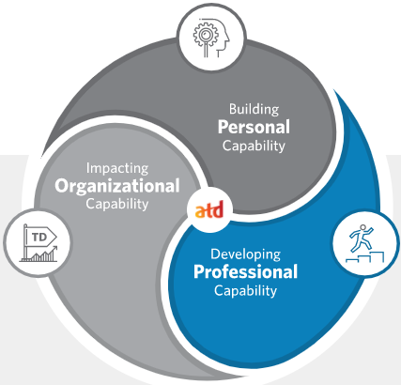
Topic: Professional Capability
Learning Sciences
Instructional Design
Training Delivery and Facilitation
Technology Application
Knowledge Management
Career and Leadership Development
Coaching
Evaluating Impact
Need some help getting started? Try these discussion questions:
What is one learning and talent technology you have used that is different in 2020/2021?
What learning and talent technology (program, feature, tool) have your discovered that has been very impactful?
Many organizations are finding that their learners are looking for curated content that they can “pull” themselves. Have you experienced this shift? If so, what systems have you used to give this to your clients?
What approaches have you taken with blended learning?
What is your current process for evaluating impact?
When have you suggested coaching or on-the-job learning instead of a more traditional training approach?
How does your organization provide the knowledge and skills needed to achieve your talent development goals? If no formal process, how do individuals acquire the knowledge and skills they need? Which capabilities from this Domain of Practice could help achieve these goals?

Slide 9
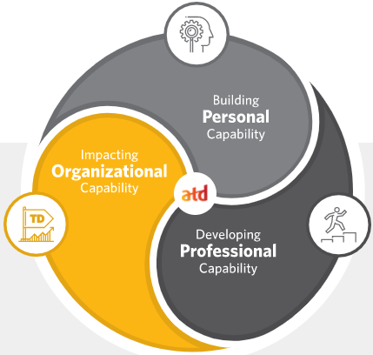
Topic: Organizational Capability
Business Insight
Consulting and Business Partnering
Organization Development & Culture
Talent Strategy and Management
Performance Improvement
Change Management
Data and Analytics
Future Readiness
Need some help getting started? Try these discussion questions:
What system have you implemented for identifying talent and addressing gaps in the organization you work with (or for)?
What steps have you taken to ensure Talent Development processes or programs meet business criteria?
What have you done to partner with all functions in your organization (or the organizations you work with)?
What role does talent development play within your organizational culture?
What are the key data and analytics you use to assess (any of) the following: Talent, Performance, Retention, Engagement, Learning
How do you collect the data and analytics that you use?
How do you ensure talent development strategies meet your organizational goals?
Have you ever experienced gaps between TD goals and company needs? If so, how can the capabilities from this Domain of Practice help?

Slide 10
What were your
takeaways today?
Notes:
Bring everyone back at 9:15-9:20
https://forms.gle/z1uAKDEH1nPUQmBR6

