Slide 1
2014 Board Orientation
Metro DC Chapter of ASTD

Slide 2
Learning Outcomes
This orientation is designed to enable you to:
Describe expectations of board members’ performance
Access GMAIL to use manage chapter communication
Access Google Drive to store, share, and create documents
Articulate the guidance provided by the Chapter By-Laws
Locate documentation about board technology
Access Wild Apricot to view contact and event information
Access Chapter Leader Resources from National ASTD

Slide 3
Learning Approach
Our approach to learning is based on:
Explanation
Demonstration
Application

Slide 4
Performance Expectations
As a group the Board has responsibility to:
Hold an active and current membership with national ASTD
Hold an active and current membership in good standing with Metro DC ASTD
Attend monthly Board meetings
Submit a portfolio project plan with a timeline of goals and annual budget for the program area
Review content for the Metro DC ASTD website and submit portfolio-related updates, as needed.
Check email and provide timely responses to requests and inquiries from members, board colleagues, and other internal and external parties.
Attend Metro DC ASTD monthly programs and special events whenever possible.
Create and maintain an active portfolio committee to support efforts.
Maintain and update records relevant to position for a successor.
Before end of Board term, recommend potential candidates for the position.
Train successors in duties for the position during transition period prior to successor’s term of office.
Follow Roberts Rules of Order when conducting meetings.

Slide 5
Executive Committee
President, Andrea Evans
President-Elect, Chris Eanes
Past President, Foster Rockwell
VP of Membership, Kathy Reiffenstein
VP of Finance/Operations, vacant
The executive committee meets the 2nd Saturday of each month from 7-9am to discuss issues, plan strategy, and make operational and strategic recommendations to the board.

Slide 6
Board Members
Director of Career Services, Pam Marshall
Provides career development activities and networking
Director of Communications, Stephanie Hubka
Oversees communication policies and processes such as website and Beltway Bulletin (monthly enewsletter)
Director of Communities of Practice, Tom Tatem
Coordinates monthly activities for our five communities of practice (COPs) that are open to anyone. COPs focus on leaderhip, free agent/business owner, instructional design, instructional technologies, and coaching
Director of Marketing, Marcella Simon
Makes recommendations for building our brand in the DC area via a variety of communication and media methods

Slide 7
Board Members
Director of Membership Outreach, Mary Lynn Billitteri
Coordinates new member orientations and networking events
Director of Professional Development, Bernadette Costello
Identifies and executes 1- and 2-way workshops
Director of Programs, Diane Elkins
Plans and manages our monthly dinner programs on a variety of topics
Director of Talent Management, Tracie Daniels
Helps directors identify and recruit volunteers for their projects
Director of Virtual Programs, Rick Blunt
Identifies and executes monthly webinars on a variety of topics

Slide 8
Gmail and Google Drive
Central login enables you to toggle between Mail and Drive https://www.google.com/a/dcastd.org
Every board member is issued a Gmail dcastd.org email address corresponding to their portfolio. All chapter-related communications should be conducted through this account. Board Directors are expected to check the account on a regular basis and use out of office notifications when they will be unable to respond within a reasonable timeframe.
All Directors are required to use Google Drive to upload drafts, final documents, contracts, and other pertinent documentation to their respective folders. Consistent use of the storage system allows the chapter to maintain continuity of decisions and manage resources needed as reference for future decisions.

Slide 9
Google Mail and Drive
Search Bar
Google Tools
Select a Tool
Toggle between Mail and Drive

Slide 10
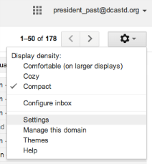
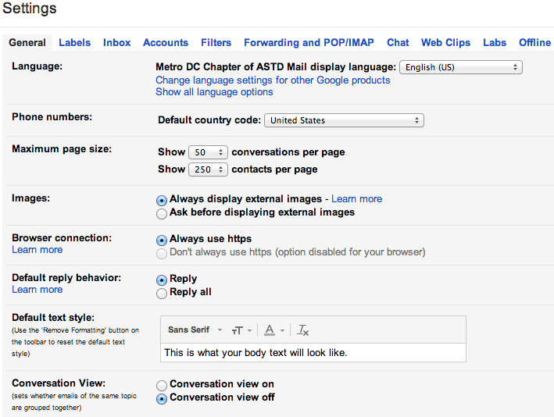
Gmail Settings
Click here for settings
Review these options

Slide 11
Personalize Gmail

Slide 12
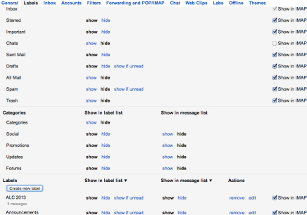
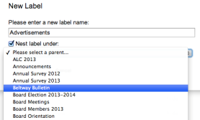
Gmail Labels
Show or hide labels
Create new labels

Slide 13
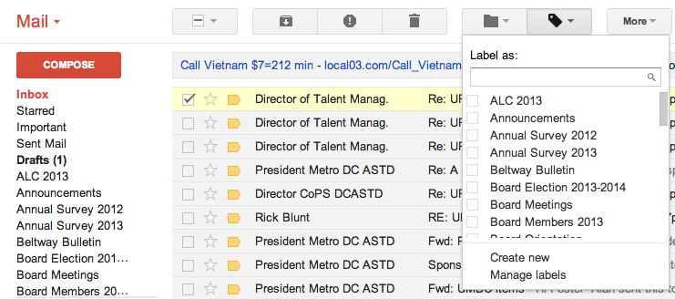
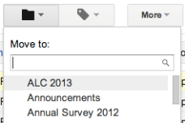
Organize Mail with Labels
Apply or create labels
Or move emails

Slide 14
Other Gmail Settings
Apply an Alias
Forward mail to another account

Slide 15
Demonstration

Slide 16
Try It!
Access Settings and create a signature
Create a new label
Apply a label to an email
Move an email to your newly created label
View the email in the labeled directory
Edit the name on your email account

Slide 17
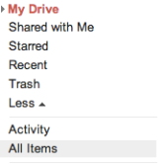
Google Drive – 1st Steps
Click the arrow next to More
All files are stored in a central repository in Google Drive. You personalize your view of files by creating and using virtual Folders nested under My Drive. Locate files or folders and drag and drop them under My Drive to create your view. The files are never actually moved. Your folders create links to those files.
Click All Items

Slide 18
Locating Folders and Files
Use Search Bar
Use Keywords
Select Content Type

Slide 19
Locating Folders and Files
Click desired content
and then
drag and drop it
To My Drive

Slide 20
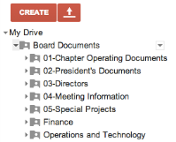
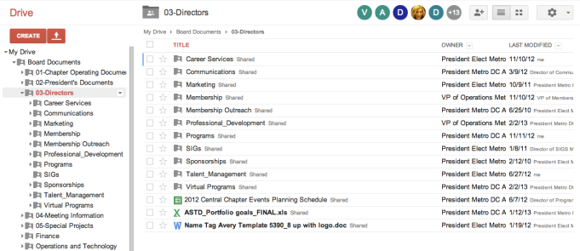
Navigating Folders
Expand and collapse folders

Slide 21
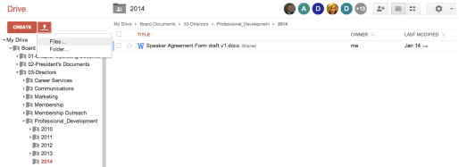
Uploading Content
Click to begin upload
Navigate to file and click Upload and share
!
Start Upload

Slide 22
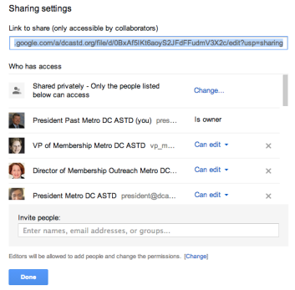
Sharing Uploaded Content
Click to share the document
Get link to share the document and edit the rights of those with whom you are sharing it.

Slide 23
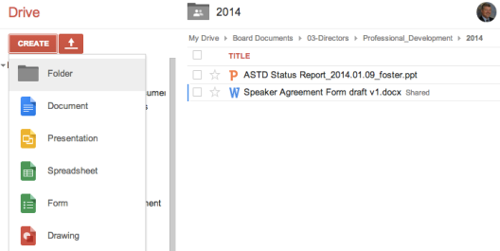
Create New Google Content
Create a Folder, or select the native Google file type to begin.
Use Google’s Help to understand the file types.
Google Drive uses propriety file formats that are very similar to Microsoft Office file types. It may be easy to understand the Google functionality if you are familiar with Microsoft Office products. The benefit of using a Google file format is that you can share and edit Google files with other board members directly online. This approach simplifies version control.

Slide 24
Demonstration

Slide 25
Try It!
Access Google Drive
Search for Board Documents
Find and add the Board Documents folder to My Documents
Expand the Board Documents folder
Navigate to your portfolio’s folder
Create a 2014 folder in your portfolio’s folder
Upload your Orientation file into the 2014 folder and share it with Past President

Slide 26
Chapter Leader Resources
There are several resources available to Chapter leaders that provide information and guidance for our roles.
Chapter By-Laws – provide governance and operational guidance
Wild Apricot – provides information often needed to make decisions about members, events, budgets and resources
National ASTD – provides templates, guidance documents, and numerous online resources for chapter leaders

Slide 27
Resources: By-Laws
By-Laws
The Chapter By-Laws describe our governance procedures and guide our operations and activities. They were last updated in 2008 and will be reviewed again in 2014.
Access Google Drive
Click All Documents
Search “By-Laws”
Click By-Laws folder
Click Metro DC Chapter By-Laws 2008
Where can the 2008 By-Laws be found in Google Drive?

Slide 28
Resources: By-Laws
Find the answers to these questions but do not share them.
Does the board have the authority to create new board positions?
Can the Chapter President exclusively remove a board member?
Can a direct serve in a position for five consecutive years?
What is the Chapter’s fiscal year?
Who approves all budgets?

Slide 29
Resources: Board Technology
The Chapter uses a variety of technology to support our efforts. Most technology requires logins and passwords. There is a technology document in Google Drive that contains information about the technology.
Access Google Drive
Click All Documents
Search “Board Technology and Resources”
Should be in folder Board Documents -> Operations and Technology

Slide 30
Resources: Wild Apricot
Wild Apricot is a multi-faceted system the Chapter licenses on an annual basis. It is the Chapter’s event management system and membership database. It also serves as our website authoring and maintenance tool.
You access Wild Apricot (WA) by logging into the Chapter website with your board email and WA password.
www.dcastd.org

Slide 31
Resources: Wild Apricot
Switch to Admin View to see Contacts and Events
Wild Apricot is a security-driven application. As a result, board members typically only have access to the parts they need to access. Viewing contact information or event information is a typical need.

Slide 32
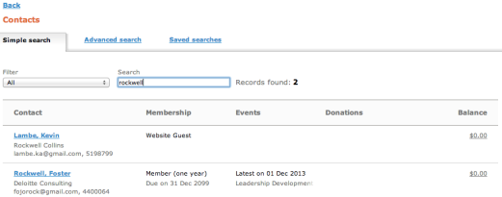
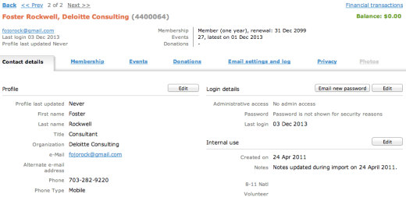
Resources: Wild Apricot
Select Contacts, enter name, and click on person.
Detailed information is displayed for that person, such as membership status.

Slide 33
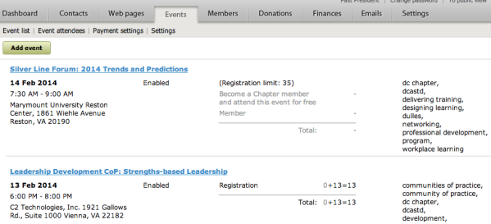
Resources: Wild Apricot
Click Events tab and then click event.

Slide 34
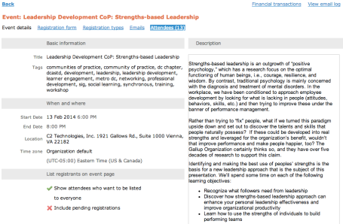
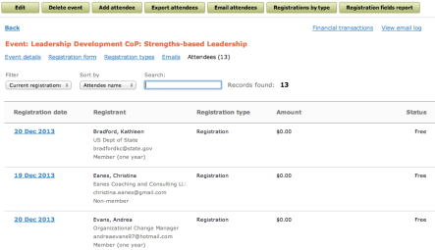
Resources: Wild Apricot
Click Attendees to view them. Export attendees to create a list.
Logout of WA when you’re done.

Slide 35
Demonstration

Slide 36
Try It!
Access Wild Apricot
When does Karen Mack have to renew her membership?
Is Dan Jackson a chapter member?
What was the last event chapter member Michelle Moore registered for?
Are there any unpaid registrants for the New Year Networking event to be held January 29?

Slide 37
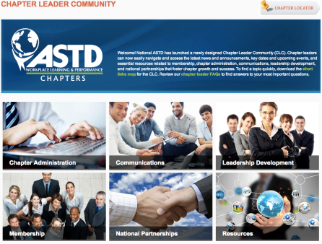
Resources: Chapter Leaders Community
National ASTD provides a centralized resource for chapter leaders on its website. There are tools, templates, samples, and networking resources for chapter leaders in general as well as for specific board positions. www.astd.org/clc

Slide 38
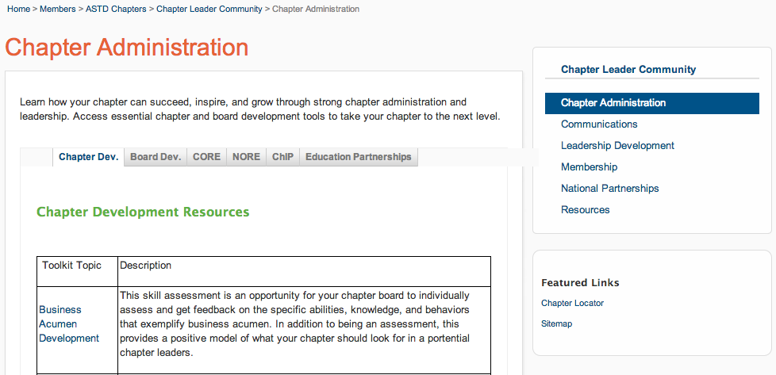
Resources: Chapter Leaders Community
Use the links to browse, explore and download resources.

Slide 39
Try It!
Access the Chapter Leaders website www.astd.org/clc
What resources did you find by Leadership Position?
Who is the senior director on the Chapter Services team?
Can you locate and download a Leader Connection Newsletter?

Slide 40
Questions and Answers

