Slide 1

ATD Leader Connection Hour
Welcome to the ATD chapter leader community!
Notes:
CALLAN
Section: Opening
Section Time: 5 minutes
Time: ½ minute
RECORD
SAY: Welcome everybody! Thank you for joining us for the ATD LCH
We have a lot to cover so we’re going to go ahead and hit the record button.
DO: Record session

Slide 2
Welcome
In Chat, let us know:
Your Name
Your Chapter
How would you define
“strategic leadership” for chapter leaders?
Notes:
CALLAN
Time: 1 minute
SAY: Welcome back to the mighty and vibrant volunteer group from across the country who are passionate about developing others and Talent Development excellence.
CHAT: To get a sense of who is here today - please share in CHAT your name and which proud Chapter you hail from.
SAY: Our goal with today’s session is to take you from the orientation content from last session and dive deeper into the topic of strategic leadership and navigating difficult conversstaions.
Please be aware that this webinar will be recorded and posted at td.org/chapterwebcasts and can be shared with fellow chapter leaders who are unable to make the call; feel free to pass this along to them.
A PDF of the slides and key links/information will also be available after the webcast.

Slide 3

Who’s in the Room?
What’s your current primary role/functional area as a Chapter Leader?
President (Current/Elect/Past)
Programming
Marketing/Communications
Finances/Sponsorships
Membership
Other
Notes:
CALLAN
Time: 1 minute
SAY: We’d like for all of us to have a better understanding of who is “in the room” today. Let us know by answering the following questions in the POLL.
POLL: Launch poll. Read question and answer options. Prompt participants to respond.
What’s your current primary role/functional area as a Chapter Leader?
President track
Programming
Marketing/Communications
Finances/Sponsorships
Membership
Other
DO: Give time for responses, close poll, and share results. IF there are “Other” responses – ASK to specify high-level what their area is in CHAT (e.g., governance, technology, onboarding, succession planning, etc.)

Slide 4
Agenda
Your Support Team
Q1 Reflection on Difficult Convos
Strategic Mindset & Filters
Difficult Conversations Case
Wrap Up & Questions
Notes:
CALLAN
Time: ½ minute
SAY: There is a lot of information in the session. Our intention is to make you, as chapter leaders, aware of resources – and then for you share what you’ve learned with your boards. You can continue to refer back to this deck/job aid with links. Here’s what we’ll cover today.
DO: Review the agenda

Slide 5
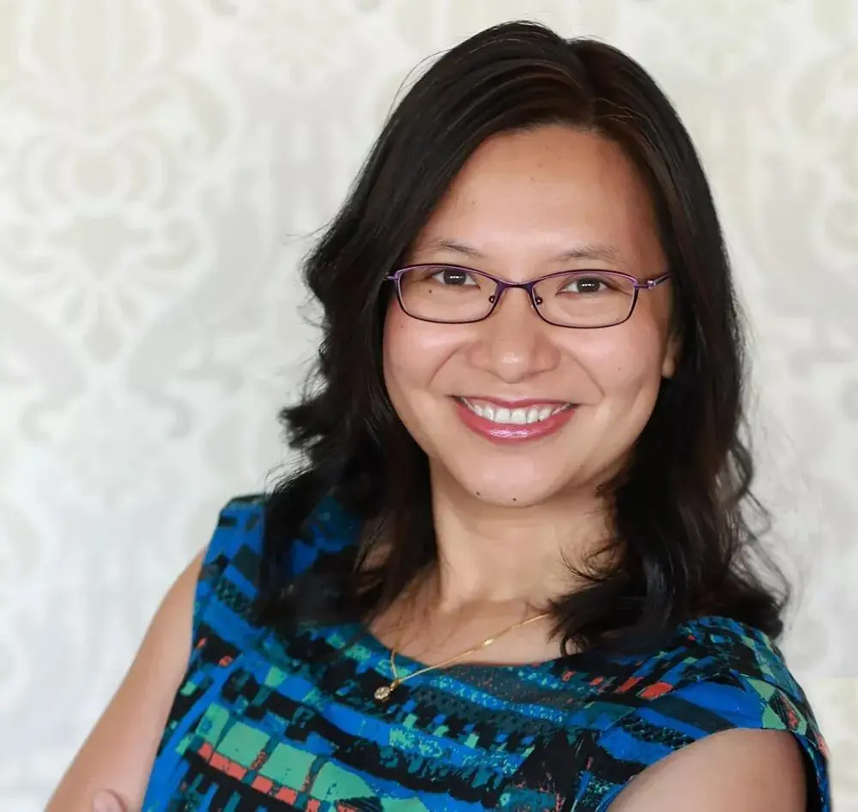

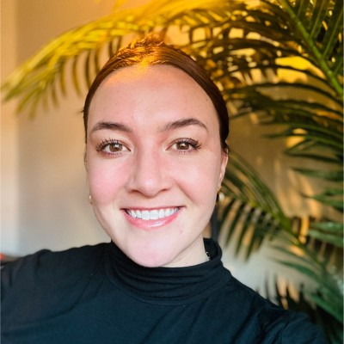

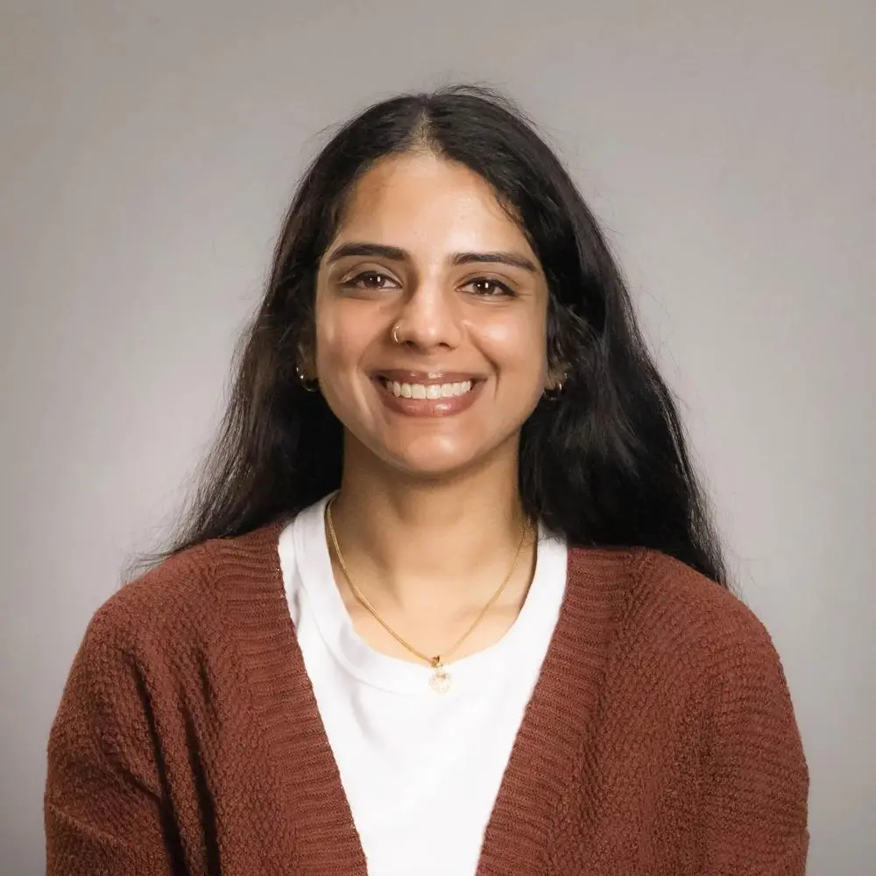
Strategic Leadership Support
Juliet Hart
National Advisor for Chapters
Home: Mid-New Jersey Chapter
Candice Hunt
National Advisor for Chapters
Home: Capital Region Chapter
Callan Swaim,
CPTD
National Advisor for Chapters
Home: New York City Chapter
Strategic Leadership Committee Chair
Lisa Torreano, CPTD
National Advisor for Chapters
Home: Houston Chapter
Shruti Nallappa
Chapter Relations Specialist, Eastern Area
ATD
Notes:
CALLAN
Time: 1 minute
SAY: We are representing the Strategic Leadership sub-Committee of the National Advisors for Chapters (NAC) Committee. NAC are volunteers (we will share more about the NAC a bit later in this call), whereas Shruti is an employee of ATD.
DO: Introduce the Strategic Leadership Committee team
Home chapters: Juliet Hart (Mid-New Jersey), Candice Hunt (Capital Region), Callan Swaim (New York City), Lisa Torreano (Houston), Shruti Nallappa Chapter Relations Specialist Eastern Area

Slide 6
Strategic Leadership Sessions
Q 1
FEB 24th
2-3pm ET
Q2
APRIL 9th
2-3pm ET
Q2
MAY 16th
@ ALC
Q3
AUG
TBD
Q4
NOV
TBD
COMPLETE
WE ARE HERE
UPCOMING
UPCOMING
UPCOMING
VIRTUAL
SPRING ORIENTATION
SESSION
VIRTUAL
LEADER CONNECTION
HOUR
IN-PERSON
BECOME A STRATEGIC LEADER
WORK SMARTER, NOT HARDER
VIRTUAL
LEADER CONNECTION
HOUR
VIRTUAL
FALL
LEADERSHIP
DEVELOPMENT
SESSION
Notes:
CALLAN
Time: ½ minute
SAY: To give you an overview of our committee is supporting you all, we wanted to flash up the different sessions we will be offering throughout the year for you all. Last month, we took you through the massive amounts of resources, toolkits, and websites that are here for you. This LCH session, is all about peer connection, diving deep into strategic leadership behviours, and of course the toughest part of the job- navigating difficult conversations.
In the future, you will see us at ALC with our session “BECOME A STRATEGIC LEADER WORK SMARTER, NOT HARDER” and then for 2 additional virtual sessions in Aug, and Nov.
DO: Review the agenda

Slide 7
How does being a strategic leader help you navigate difficult conversations?
Notes:
CANDICE
Time: ½ minute
SAY:

Slide 8
Let’s Reflect
In Triads, discuss:
1. One difficult conversation you've had or difficult decision you've made recently with the intent of being a more strategic leader
2. How you justified that decision or having that difficult conversation
Notes:
CANDICE
Time: 15 minutes breakouts
SAY: Since our orientation session last month, which you may have been on, or some of your peer board members, what is one difficult decision you have had to make with the intent of being a strategic leader? How you justified and communicated that decision to your board/chapter

Slide 9
How do you justify having a difficult conversation?
What is your intent?
Notes:
CANDICE
Time: 5 min debrief
SAY:

Slide 10
Common Difficult Conversations
 | DOING | LEADING ​
A new board member is stuck | Jump to solutions immediately​ | Ask strategic questions first​
Adding a formal structure or process | Focused on how to fix the problem​ | Questioned whether the problem needs to exist or be eliminated/replaced​
"But, we've always done it this way" | Debates the idea in detail | Anchors in purpose, priorities, and trade-offs.
Yearly board strategic planning | Grabs first for tasks, especially urgent ones. | Clarifies what matters, then assigns owners and empowers them.​
A volunteer is taking a stretch project | Frequently steps into operational details | Stays at the right altitude: asks for plans, milestones, and risks- not every step.
A board member is ghosting | Quietly takes work back or works around underperformers. | Names the pattern and links it to impact on the board.
Notes:
JULIET
Time: 5 minutes
DO: Walk through the table and ask for examples from chapter leaders in the chat of “doing vs. leading.
On slide: Examples
Animation 1: DOING examples
Animation 2: LEADING examples
SAY:

Slide 11

Strategic Filters
A tool to eliminate justifications that are linked to emotion and to prioritize justifications that are linked to chapter, strategy, goals, and mission.
Filters Examples | LEADING ​
Mission Alignment | “Does this clearly serve our members and advance our mission?”
Long-Term Impact | “Will this matter in 2–3 years?”
Resourcing | “Is this the best use of our limited volunteer capacity?”
CARE | “Does this align with ATDs expectations of our chapter? (CARE)
Communication | “Does this decision have a clearly articulated ‘why’?”
Notes:
JULIET
Time: 5 minutes
DO: Introduce and walk through the definition/ table and ask for examples from chapter leaders in the chat of “strategic filters”. Call out ”difficult conversations” icons and add personal experience of when you had to this
SAY: How many times have you seen decisions be made because it was “liked” or was “exciting” vs. it being what was truly needed?

Slide 12
In Triads take turns,
1. Hot Seat Leader briefly describes an upcoming difficult conversation and current “doing plan” that they might typically take
2. Two peers ask only strategic filter-based questions
3. Hot Seat Leader make a strategic shift offering a new “leading plan” that they can implement that aligns with chapter goals
Let’s Try it On
Notes:
LISA
Time: 15 minutes breakouts
It's your turn to try it on! Think of an upcoming difficult convo you need to have and with Tiads you will practice using strategic filters
Examples of strategic lens questions on the next page

Slide 13
Strategic Question Examples
Filters | LEADING ​
Mission Alignment | “Where’s does the disconnection to the mission ?”
Long-Term Impact | “if this convo doesn’t happen, how might this look in 3 years?”
Resourcing | “How is this impacting our volunteer capacity?”
CARE | “Will this prevent the chapter from get CARE PLUS?”
Communication | “How will this decision land in the current board/chapter environment?”
Notes:
LISA

Slide 14
What happens if you don’t have these difficult conversations?
Notes:
LISA
Time: 5 min debrief activity
POINTS TO DRIVE HOME:
Difficult conversations are difficult because many times the receiver perceives the reasoning as personal
Use strategic filters to remove that "personal perception" and support you in identification, justification, and preparation of the difficult convos
This way it aligns to the chapters vision and misson vs. A persoal option or emotion

Slide 15
Lock it in!
In Chat, let us know:
What’s one thing you learned and one action you commit to taking?
Notes:
LISA
Time: 2 minutes
SAY: Make a plan to take action and drop it in chat

Slide 16

Next Steps
  Discuss your strategic filters with your board
  Collaborate with your chapter board to achieve CARE
  Reach out to your Chapter Relations Specialist (CRS) and National Advisor for Chapters (NAC) with questions
  See you at ALC in May!
Notes:
CALLAN
Time: 1 minute
SAY: What’s Next? Here are some action items your chapter can take as you move forward. We’ve listed some here for you to get started. What else is next for you?
DO: Review ideas on screen
Discuss your strategic filters with your board
Collaborate with your chapter board to achieve CARE
Reach out to your Chapter Relations Specialist (CRS) and National Advisor for Chapters (NAC) with questions
See you at ALC in May!

Slide 17
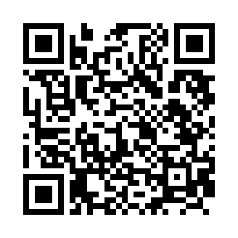
Feedback is a gift!
Please take 1 minute to share your feedback about this session:
https://atdorg.formstack.com/forms/lch_2026_feedback_survey
Notes:
CALLAN

Slide 18

Questions
Notes:
Full team to handle questions

